Slide 1

watsonx.ai Seller presentation Jessica Ridella jnridell@us.ibm.com World Wide Sales Lead for watsonx.ai Felix Lee felix@ca.ibm.com Principal, Learning Content Development AI and Data Anshupriya Srivastava anshupriya.srivastava@ibm.com Advisory, Learning Content Development, AI and Data
Notes:
IBM watsonx represents the latest offering and innovation available to IBM clients to provide businesses with a complete AI platform for their needs. Watsonx has 3 components: watsonx.ai (the studio for training and tuning ML models and foundation models), watsonx.data, and watsonx.governance. This deck is a guide for sellers on how to identify watsonx.ai opportunities and progress them.

Slide 2
Seller guidance and legal disclaimer
Slides in this presentation marked as "IBM and Business Partner Internal Use Only" are for IBM and Business Partner use and should not be shared with clients or anyone else outside of IBM or the Business Partners’ company.
© IBM Corporation 2024. All Rights Reserved.
The information contained in this publication is provided for informational purposes only. While efforts were made to verify the completeness and accuracy of the information contained in this publication, it is provided AS IS without warranty of any kind, express or implied. In addition, this information is based on IBM’s current product plans and strategy, which are subject to change by IBM without notice. IBM shall not be responsible for any damages arising out of the use of, or otherwise related to, this publication or any other materials. Nothing contained in this publication is intended to, nor shall have the effect of, creating any warranties or representations from IBM or its suppliers or licensors, or altering the terms and conditions of the applicable license agreement governing the use of IBM software.
References in this presentation to IBM products, programs, or services do not imply that they will be available in all countries in which IBM operates. Product release dates and/or capabilities referenced in this presentation may change at any time at IBM’s sole discretion based on market opportunities or other factors and are not intended to be a commitment to future product or feature availability in any way. Nothing contained in these materials is intended to, nor shall have the effect of, stating or implying that any activities undertaken by you will result in any specific sales, revenue growth, or other results.
All client examples described are presented as illustrations of how those clients have used IBM products and the results they may have achieved. Actual environmental costs and performance characteristics may vary by client.
IBM and Business Partner Internal Use Only
Notes:
Include this slide when using content that needs to be shared only with IBM and Business Partners.
Include this text as the speaker notes for this slide: This self-explanatory slide shares seller guidance and legal disclaimers for this presentation.

Slide 3
Content
The AI landscape
IBM Watson and AI
Traditional and generative AI
Foundation models
Generative AI use cases
Benefits and risks
Enterprise requirements
Watsonx and watsonx.ai
Watsonx family
Watsonx.ai components
Foundation model library
Prompt Lab
Tuning Studio
Hugging face partnership
Watsonx.ai and other IBM technology pillars
Watsonx.ai competitors
Sellers – call to action
Notes:
This self-explanatory slide provides a table of contents for this presentation.

Slide 4
Gartner reports:
Global spending on artificial intelligence (AI) software will grow to $298 billion by 2027
Gartner Forecasts Companies to Increase Spend on AI Solutions from 8% in 2023
to 35% by 2027.
…spend is up but it does
not mean that AI always comes easy
$298B¹
35%
¹
Source: Invest Implications: Forecast Analysis: Artificial Intelligence Software, 2023 – 2027, Worldwide, 09 November 2023
Notes:
AI today is a 100-billion-dollar business that’s expected to grow to nearly two trillion dollars by 2030. According to Gartner, the global spending on AI software will reach an impressive 298 billion dollars in 2027, with companies increasing spending on AI to 35% by 2027.
AI has seeped into almost all facets of everyone’s personal and professional lives; in ways many are not probably aware of.
An AI conference is a good place to be to feel the excitement around the promise of AI. Clients will hear about all the good that AI offers across industries, from new generative models, improved customer interactions through chatbots, and customer service menus, to proactive medical analysis, fraud mediation, improved supply management, and everything in between. But the fact is successful AI does not always come easy.
The buzz around AI today is all about foundation models and generative AI. One very important thing to remember is that a solid foundation in machine learning and traditional AI, the lessons learned, techniques used, and the life cycle processes all do carry over.
Source
1. Invest Implications: Forecast Analysis: Artificial Intelligence Software, 2023-2027, Worldwide - https://www.gartner.com/en/documents/4925331

Slide 5
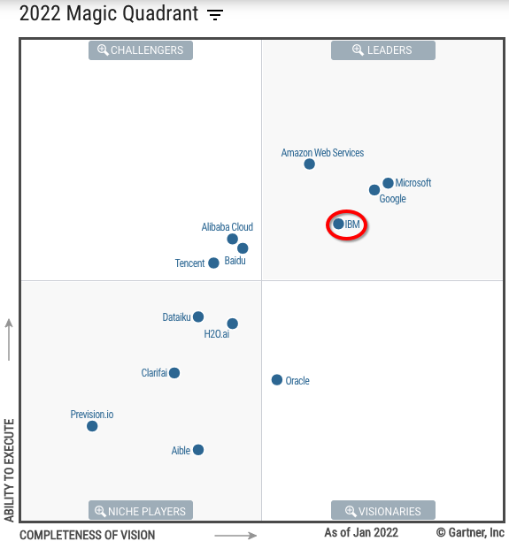
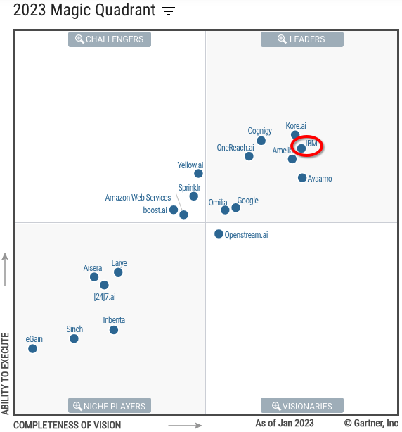
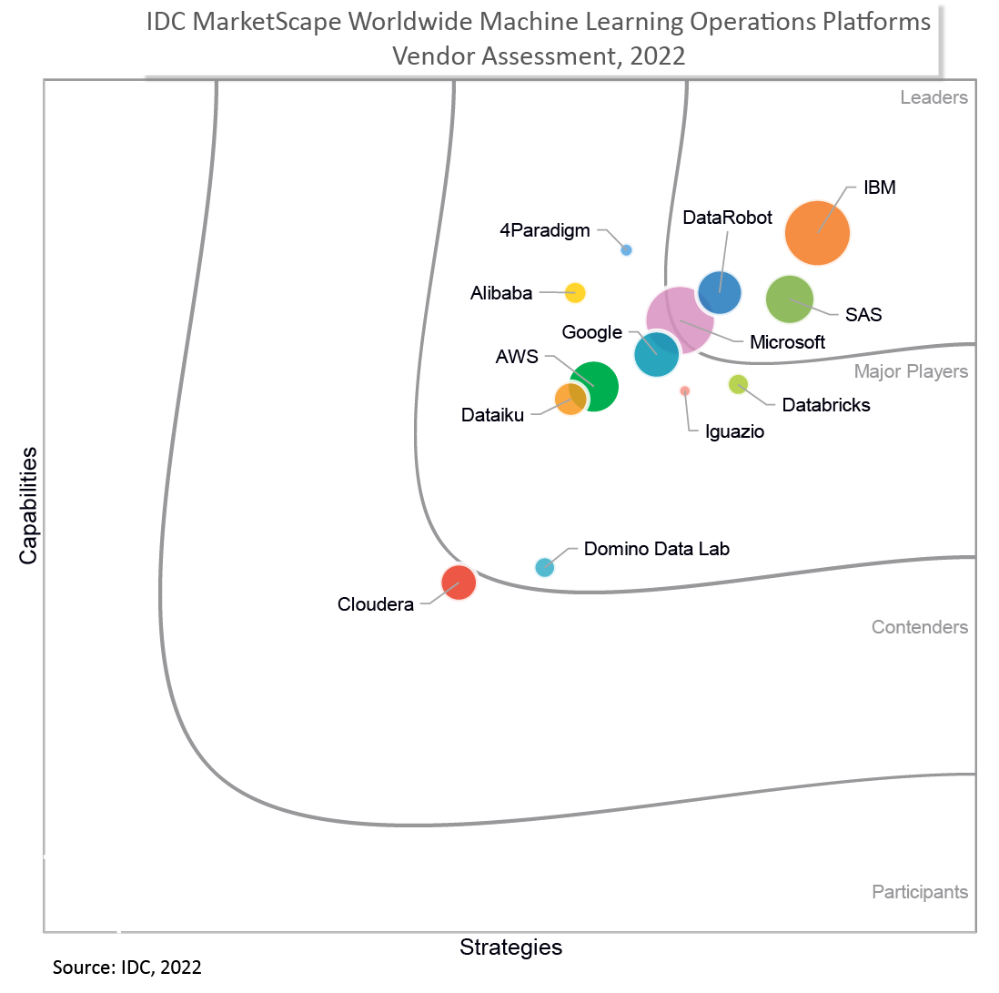
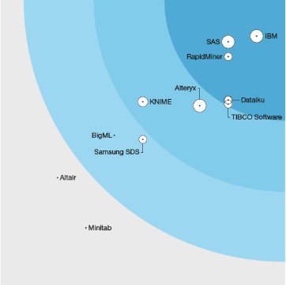
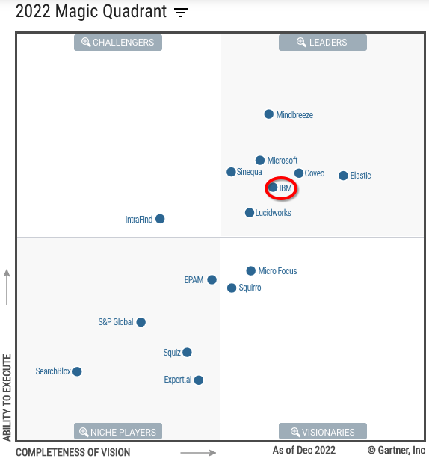
IBM is a leader in AI
MQ for Cloud
AI Developer Service
MQ for Enterprise
Conversational AI Platforms
IDC Marketscape: Leader in Worldwide Machine Learning Operations Platforms 2022 Vendor Assessment
MQ for Insight Engines
Forrester Wave:
Multimodal Predictive Analytics and Machine Learning
Multiple Gartner Magic Quadrants for AI-related capabilities
Notes:
This self-explanatory slide shows that IBM is recognized as a leader in artificial intelligence (AI) in the marketplace according to top analysts such as International Data Corporation (IDC), Gartner, Inc., and Forrester Research.
Sources:
IDC Marketscape: Leader in Worldwide Machine Learning Operations Platforms 2022 Vendor Assessment: https://www.ibm.com/account/reg/us-en/signup?formid=urx-51950
Forrester Wave 2023: Data Management For Analytics: https://www.ibm.com/blog/ibm-named-a-leader-in-the-forrester-wave-data-management-for-analytics-q1-2023
Forrester TEI for IBM Data Management: https://www.ibm.com/downloads/cas/9X4AX5WK
Gartner MQ for Cloud AI Developer Services: https://www.gartner.com/document/4014812?ref=solrAll&refval=367313295
Gartner MQ for Conversational AI: https://www.gartner.com/document/4154599?ref=solrAll&refval=367313557
Gartner MQ for Insight Engines: https://www.gartner.com/document/4022148?ref=solrAll&refval=367313691

Slide 6
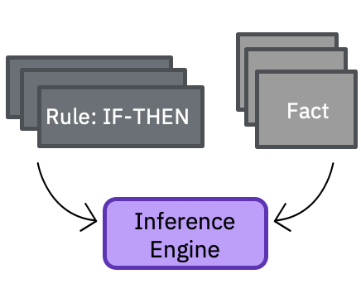
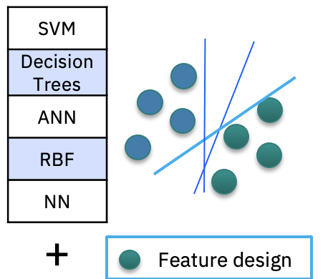
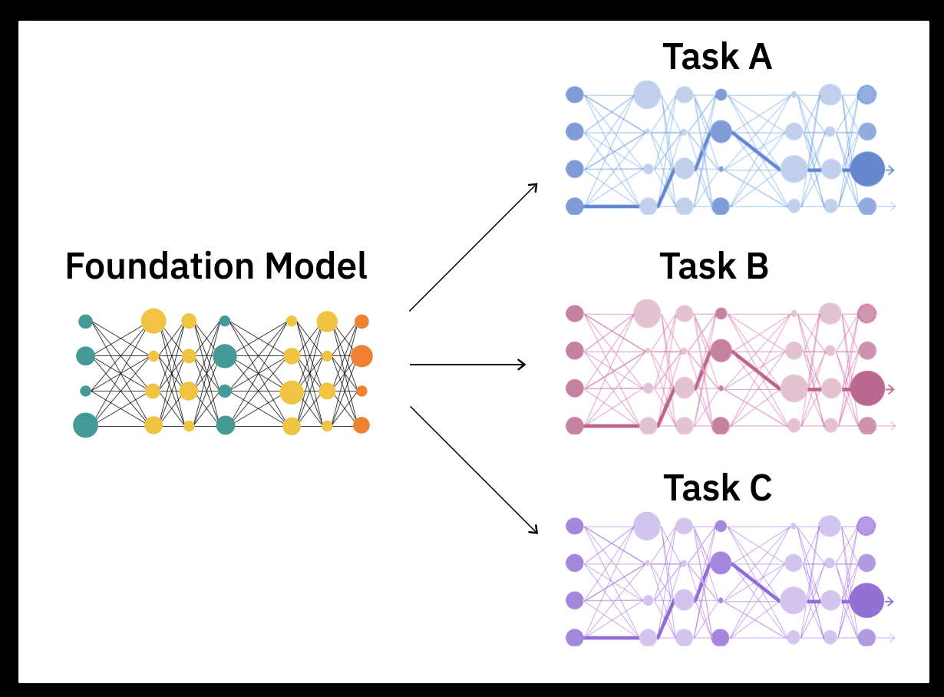
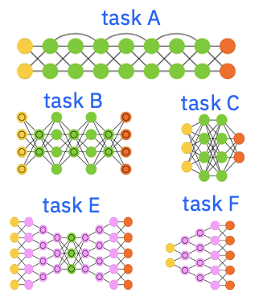
The story of AI is a story of data representations
1980s
Big data
1980s to ~2010s
Massive labeled data + Compute
2017+
Self-supervision at scale
+
Massive unlabeled data + Compute
Expert systems
Rule engines
Machine learning
ML algorithms
Task-specific decision boundaries
Deep learning
Network architectures
Task-specific decision boundaries + feature representations
Foundation models
Base model
Adaptable decision boundaries and feature representations
Notes:
Generative AI represents the latest innovation in the long history of the artificial intelligence (AI) journey on data representations. It began with expert systems and early inference engines in the 1980s using symbolic representations of data.
The modern era of AI and machine learning (ML) began in the 1980s and culminated in deep learning in the later part of the 2010s. These models required a massive amount of labeled data to train. The resulting models were targeted for specific tasks and while these models could be successful, they were expensive (finding and labelling sufficient data) and not easily transferrable to other tasks not initially thought about when model training began. Solving different tasks (even though they may be related) required another set of labeled data and retraining. Such task-specific learning models were not scalable and became expensive. This is analogous to training an intern to understand and interpret legal documents versus medical content. These industries have different vocabularies, ways of thinking, and ways to resolve gray areas, among other differences.
New ideas, innovation, and new techniques began to emerge in the late 2010s to provide the next leap in AI modelling – foundation models and generative AI. Unlike the traditional ML and AI models, foundation models are trained on massive but unlabeled data sets and use self-supervised learning. Foundation models have a much broader base (foundation). Today, Large Language Models (LLMs, a type of foundation model) have proven to be very useful, especially in initial applications for areas in natural language processing (NLP) tasks.

Slide 7

The speed, scope, and scale of generative AI impact is unprecedented
Massive grassroots adoption
Broad-reaching and deep impact
Generative AI could raise global GDP by 7% within 10 years
1 M
users within 1 week
100 M
users within 2 months
- Goldman Sachs
Generative AI has democratized AI and accelerated the largest commercial opportunity in today’s economy, sized at USD 15.7 trillion of GDP by 2030.
IBV Tech-led disruptions
are accelerating, driven by Generative AI
Notes:
The speed, scope, and scale of generative AI impact is unprecedented. ChatGPT burst into the public landscape in November 2022 and within 1 week had 1 million users and passed the 100 million users mark in only 2 months. In comparison, it took much longer for almost (if not all) any popular social media platform to reach the 1 million mark as shown in the diagram on the left slide of this slide.
ChatGPT’s impact is raising public awareness of the huge potential and capabilities of generative AI. However, the impact is not just for the public sector. Goldman Sachs notes that generative AI could raise global gross domestic product (GDP) by 7% within 10 years. The IBM Institute for Business Value (IBV) Future Trends Research survey noted that executives expect 48% of their employees to use generative AI to augment tasks within the next year (2024) alone.
IBM aims to provide an artificial intelligence (AI) platform whereby enterprises can unleash the power of generative AI in a safe, customizable, responsible, and explainable manner that is controlled and owned by clients instead of a general-purpose “black box.”
Sources:
Goldman Sachs article – “Generative AI could raise global GDP by 7%”: https://www.goldmansachs.com/insights/pages/generative-ai-could-raise-global-gdp-by-7-percent.html
BCG, Generative AI: https://www.bcg.com/x/artificial-intelligence/generative-ai
IBV Tech-led disruptions are accelerating, driven by Generative AI: https://www.ibm.com/thought-leadership/institute-business-value/en-us/report/seven-bets/generative-ai

Slide 8

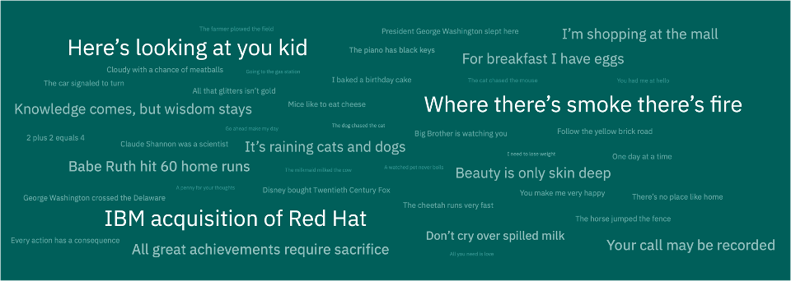
Foundation models are …
Pre-trained
On unlabeled datasets of different modalities (e.g., language, time-series, tabular)
Self-learning
Systems that leverage self-supervised learning
Self-supervised
training
Multiple applications
Able to learn generalizable and adaptable data representations that can be effectively used in a variety of domains and tasks (code generation, question answering, sentiment analysis)
Large language models
A type of foundation model trained withy language-related data
ChatGPT is based on a large language model
Foundation model
Notes:
Why are foundation models so powerful? At a high level
Foundation models are pre-trained. Unlike other machine learning (ML) models that clients will have to train (providing labeled data, working in an iterative process, monitoring, deploying, and maintaining), foundation models come pre-trained with huge and different unlabeled datasets. Clients can use them as is.
Foundation models can be further tuned with small sets of labeled data for downstream tasks for which they were not built for.
Foundation models are not specific to any tasks and can be used to apply to many tasks such as generating code snippets, answering questions from legal, medical, architectural, procedural, analyzing sentiments, and many more. Foundation models are quite good “as-is” and require much less additional data to provide additional refinements to better support specific tasks.
The most typical tasks today are natural language processing (NLP) tasks. The types of foundation models for these language-related tasks and data are called large language models (LLMs). Note that LLM is more than how humans communicate; for example, programming languages also fall into the domain of LLM. ChatGPT is based on a LLM.
The strength of foundation models is that they are generally quite capable (as is) and are easily adapted to perform specific tasks with a fraction of the training required to build a task-specific traditional AI model.

Slide 9
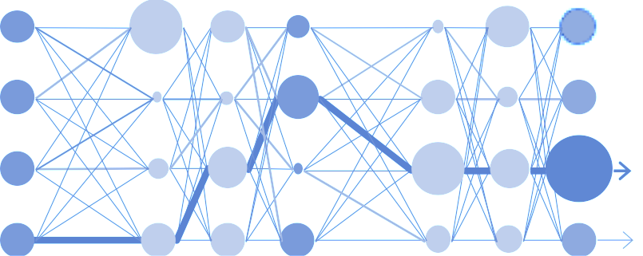



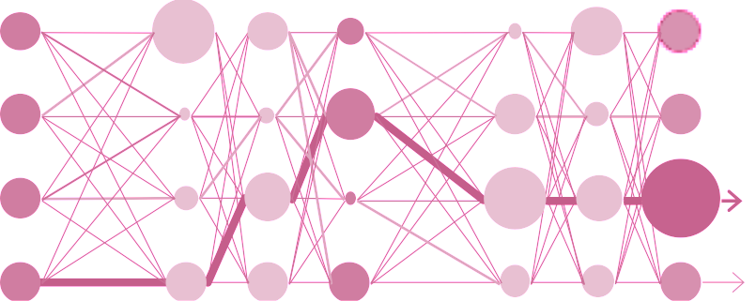

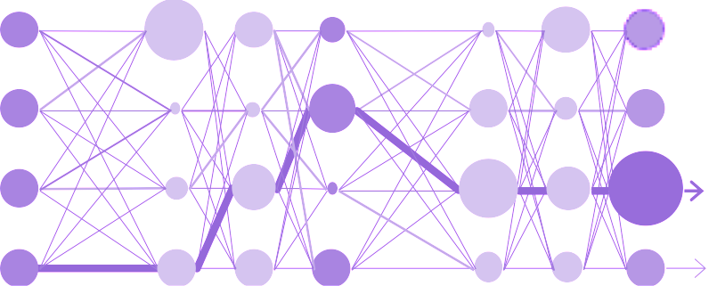

Foundation models: generalizable and adaptable
Translation prompt
Translated input
Summarization prompt
+
Input text
+
Summarized input
Answer finding prompt
Answer to the input question
Translation
model
Task-specific
fine-tuning
+
Summarization
model
Answer finding
model
Notes:
Foundation models can easily be adapted to take over downstream tasks for which they were not originally built for using labeled data.
In the simplest form, a foundation model platform knows sufficient general knowledge to be able to generate meaningful responses to various tasks (translation, summarization, finding answers). Given a sufficiently large set of training data (without the expensive labeling), a foundation model can usually perform quite well at specific tasks. A foundation model platform provides a prompt mechanism where users can input some text and generate a response. The foundation model will take the input and generate the desired output.
Users can also provide task-specific fine-tuning (with data and input specific to the task). Foundation models can then be easily adapted to create the appropriate task model (for extraction, summarization, or to find answers to general questions). Foundation models require a small (much smaller than traditional AI) set of labeled data to fine-tune for specific tasks, and they can easily be adapted for many different tasks with much less effort than traditional AI.
Enterprise clients will likely want to adapt foundation models to their specific use. Successful vendors provide ease of fine-tuning for their foundation models.

Slide 10
Leveraging foundation model capabilities across various domains
 | Customer Care Watson Assistant, Cloud Pak for Data | Digital Labor Watson Orchestrate, Cloud Pak for Integration/Automation, Wisdom in Ansible | IT Operations Turbonomic, Instana, Cloud Pak for Watson AIOps | Cybersecurity QRadar, Cloud Pak for Security
Summarization Summarizing large documents, conversations, and recordings to key takeaways | Call center transcripts Omnichannel journey summary Summarizing search snippets to augment chatbots Summarize events, analyst reports, financial info etc. for advisor Sentiment analysis | Summarize documents, contracts, technical manuals, reports, etc. Transcribe videos to text and summarize Summarizing reports on Form 10K | Summarize alerts, technical logs, tickets, incident reports, etc. Summarize policy, procedure, meeting notes, etc. Vendor report QBR summarization | Summarize security event logs Summarize steps to recap security incident Summarize security specs
Extraction Extract structured insights from unstructured data | Extracting interaction history with clients Extract information from specific types/categories of incidents | Extract answers and data from complex unstructured documents Extract information from media files such as meeting records, audio, and video | Extract key information from various sources for report automation Extract relevant system/network information for administration, maintenance, and support purpose | Extract information from incidents, content for security awareness Extract key security markers and attributes from new threat reports.
Generation Generate AI to create text | User stories, personas Create personalized UX code from experience design Training, and testing data for chatbots Automate responses to emails and reviews | Automate the creation of marketing material and language translation Automate image, text, and video creation for articles, blogs, etc. Create automation scripts for various workflows across applications | Create technical document from code Automate scripts to configure, deploy, and manage hybrid cloud Co-pilot to create code across multiple programming languages | Automate report generation Social engineering simulation Security documentation creation Automate threat detection by looking for anomaly patterns
Classification For sentiment or topics | Classify customer sentiments from feedback or chatbot interaction Classify typical issues raised by clients for focused improvements | Classify documents by different criteria – types, contents, keywords Sort digital contents in storage into pre-defined categories | Classify incident reports Automate workflow based on analysis of items/status/reports | Classify flagged items properly as threats or other categories Classify the type of security risks and find the best response Classify log and other monitoring output to determine the next action
Question answering Knowledge base search across the company’s proprietary data. | Knowledgebase articles Augment chatbot w/search Agent assist Contract intelligence mart search in technical manuals, HR documents, ethics codes, product documentation, etc. | Analyze emails, attachments, documents, invoices, reports, etc. Knowledge search for company information to provide in-house day-to-day assistance and automation | Knowledge search for IT helpdesk Ticket resolution by suggesting solutions from resolved tickets Error log and root cause analysis Compliance monitoring | Knowledge search across security spec documents External threat intelligence Error log and root cause analysis Security incident search @ forensics
Notes:
This self-explanatory slide details how clients can leverage foundation models (and generative AI) to support these five popular use cases:
Summarization
Extraction
Generate
Classify
Question answering
Use cases are described for 4 business areas: customer care, digital labor, IT operations, and cybersecurity. Of course, there are other opportunities not detailed on this slide.

Slide 11
Generative AI has benefits, but should be used with caution
Generative AI
Great at NLP tasks
There are risks
AI techniques that learn a representation of artifacts from data, and use it to generate brand-new, completely original artifacts that preserve a likeness to original data. - Gartner
Generative AI is trained on foundation models with massive amounts of data.
The most well-known type of foundation models are large language models (LLMs) used with natural language processing (NLP)
Generative AI from LLMs like ChatGPT are good at:
Creating personal performance, summary reports and resumes
Passing bar exams
Generating original write up on various topics with little input
Providing great chatbot interactions
But is this what businesses need from generative AI?
Training requires good AI skills and talent
Privileged few – to build requires huge R&D and hardware resources available to few vendors
Easy to be misused
Black-box nature – insufficient transparency and difficult to understand
Non-technology concerns, but what should businesses look for in a generative AI platform?
Notes:
With foundation models, the artificial intelligence (AI) industry has arrived at the era of generative AI. As the name implies, this is used to generate entirely new content.
Gartner defines generative AI as; “AI techniques that learn a representation of artifacts from data, and use it to generate brand-new, completely original artifacts that preserve a likeness to original data.”
Generative AI is trained on foundation models and the most popular ones are trained on large language models (LLMs) which are especially effective in natural language processing (NLP) tasks. This is made popular with the success of ChatGPT.
ChatGPT is great for things such as
Creating personal performance, summary reports, and resumes
Passing bar exams
Generating original write up on various topics with little input
Providing great chatbot interactions
But is this what businesses need from generative AI? Despite its powerfully demonstrated capabilities, there are various risks associated with foundation models, such as
Foundation models like LLMs are quite good for general consumption. “Quite good” however, is not that useful for businesses. Foundation models are complex and to train them for specific tasks requires good AI skills and talents.
The creation of foundation models requires a massive amount of data as well as significant compute resources (some of the models are now using multiple billions of parameters) – building models to this scale is only possible for a few large enterprises with massive research and development (R&D) budgets available. This means that it is concentrated on a small number of vendors.
As shown with ChatGPT, it is quite easy to misuse foundation models to produce malicious code or content (see https://tinyurl.com/y6kzxu3v). How can a business control how its foundation model is used? How can they ensure that it is safe and that any data passed into it won’t be misused?
Most foundation models are “black box” in nature. What data is used to train and how it is trained are not known. This raises an issue of trust when it is difficult to understand how the “black box” operates.
These are not technology issues, but operational issues.
Source:
Gartner Hype Cycle for Artificial Intelligence, 2022: https://www.gartner.com/en/articles/what-s-new-in-artificial-intelligence-from-the-2022-gartner-hype-cycle

Slide 12
Clients cannot just use any generative AI platform
Generative AI platform questions
How was it trained?
Garbage in → garbage out
An enterprise cannot use a foundation model trained with Web crawl
The training material needs to be huge and comprehensive but must also be curated
Can it detect & minimize bias & hallucinations?
How does the platform detect and correct bias?
How can it prevent hallucination (providing random and untrue answers with absolute aplomb and convictions)?
Is it transparent?
Open vs black-box
How to audit and explain the model, and the answers it generates?
Does the model track drift and bias? And how does it address them?
Does it support regulatory compliance?
How do foundation models and their usage comply with privacy and government regulations?
What are the guardrails?
Who is responsible for an inadvertently exposed PII or a “wrong answer”?
Is it safe?
Who has control over the model, input data, and output data?
How to ensure that confidential information is not given out?
How is it monitored?
What safety features and guardrails are in place?
Can it be customized?
Hybrid and multicloud?
Can the model be fine- tuned with clients’ data?
How can clients update, and extend the model to make it more suitable for their use cases?
How to integrate with applications? What APIs are in place?
Notes:
Foundation models, in particular large language models (LLMs) and transformers have been around for some years. The seminal paper “Attention is All You Need” was published in 2017 and IBM Watson has been using LLMs and foundation models to apply to natural language processing (NLP) tasks. IBM products such as Watson Text to Speech, Watson Speech to Text, and Watson Assistant are good examples. Other vendors have made similar advances. In 2021, Google demoed an early version of the BERT model that can carry on a fairly intelligent conversation with a human user. It’s key to remember that foundation model technology is not brand new and did not spring into being suddenly with ChatGPT.
What ChatGPT did was show the opportunities and vast potential of using LLMs with day-to-day operations? Its ability to generate well-crafted natural language answers to user queries shows the power of generative AI. However, there is a big difference between making something consumable by the general public versus using it for enterprise production dealing with sensitive, confidential, and proprietary data.
There are many big concerns enterprises should understand, such as:
How was the model trained? Generative AI is built on foundation models (in which LLMs is a specific case and ChatGPT is the prime example) that are pre-trained on huge data sets. But what is that data set? ChatGPT was trained on a large body of text and code from a variety of sources (like Wikipedia, Reddit, and more). While there is definitely useful information from these sources, there are also untruths, misrepresentations, hate, abusive, and prejudiced content; and these bad contents create a garbage in-garbage out scenario. If the data used to train a model has not been fully vetted, the contents can be (very likely to be) inaccurate, full of misleading information or mistakes that are difficult to identify. A model cannot tell what is true and what is false and has little ability to assign any ethical and moral values to the information on its own. So, the question is not the volume of data or the number of parameters used – these reflect the sophistication or raw compute power used. What an enterprise must make sure is that the training data is properly curated. Data that has the highest quality, has been vetted with clear lineage and history.
Can it detect and minimize bias and hallucination? Models built with inherent biases will produce biased results. A hallucination occurs when a model simply makes up answers based on its best guess. The answer can be factually incorrect, irrelevant, or nonsensical: but sound plausible (which makes it all the more concerning for enterprise clients). While some of these outputs may be fodders for laughter in general usage, they can be extremely damaging for an enterprise like Google’s experience (see https://tinyurl.com/yc38cfm8 where Google’s parent company Alphabet saw its stock lost 100B in value after Google’s Chatbot gave a wrong answer). The difficult part is that, unlike a human, generative AI delivers its answers with conviction and no reservation, making it very difficult for the average user to detect the mistake until it is too late.
Is it transparent? Related to this is how to audit a model, or explain how it is generating the results. Something like ChatGPT is essentially a “black box” and it brings little comfort and confidence to enterprises as there is simply little to no information on how it arrives at the response/answer.
How is the model being monitored? Does it track model drifts and bias? What corrective mechanisms are in place? These need to be transparent to clients.
Does it support regulatory compliance? Generative AI’s mass appeal is its ability to create entirely new and very convincing material. For an enterprise, however, there are many regulatory concerns:
How do LLMs comply with existing regulations; for example, the European Union (EU) General Data Protection Regulation (GDPR), and the Health Insurance Portability and Accountability Act (HIPAA), among others? How can an LLM keep up with new regulations that are sure to arise to regulate the exploding popularity of generative AI?
What guardrails are being put in place by the tooling vendors?
Who is responsible if the LLM model generates a wrong answer, or if it inadvertently discloses personally identifiable information (PII)?
How to make this technology accountable, answerable, and auditable?
Is it safe?
When using an LLM model, who is in control? Can an enterprise have any control (or at least full transparency) over what data was used to train it?
How can the enterprise control the quality of the output?
Can the enterprise be sure that interaction with such a model will not result in confidential information and data being disclosed or leaked to a third party?
Can the platform be monitored effectively for data flow? What features are available to help clients understand, control, and safeguard their business capital?
Can it be customized?
Can the platform be run in a private setting to ensure safety? What about multicloud?
A general model may be good for general queries, but how can an enterprise train it with its own data to support tasks specific to it?
Can clients update and modify the model to make it more suitable to their specific industry and business? Can these models be extended?
What application programming interfaces (APIs) are available to operationalize the platform?
How can enterprises integrate their existing applications with the LLM?
Addressing these issues is important for foundation models and generative AI vendors to provide a viable product for clients.

Slide 13
Put AI to work with watsonx
Scale and accelerate the impact of AI with trusted data on hybrid cloud
watsonx.ai
watsonx.data
watsonx.governance
Train, validate, tune and deploy AI models
Scale AI workloads, for all your data, anywhere
Enable responsible, transparent and explainable data and AI workflows
Red Hat OpenShift provides scalability, hybrid capability
Notes:
Enterprise AI needs to be portable, efficient, and sustainable. But the largest models are expensive, energy-intensive to train and run, and complex to deploy. By building on hybrid cloud technologies, IBM allows clients to optimize for performance, latency, and cost.
IBM watsonx is built on Red Hat OpenShift that allow clients to access and deploy their AI workloads in any IT environment, no matter where they’re located. It can run on multiple clouds, including IBM Cloud, Amazon Web Services (AWS), and Azure, on clients’ premises, and even on the edge.
IBM watsonx allows clients to seamlessly and safely move their AI workflows between public and private clouds, making it easier to securely process and store data on servers that they own or lease. This gives clients the flexibility to rapidly scale AI applications. If clients have data in the cloud, IBM can bring its stack to them. If clients’ data is on-premises, they can train and tune their models there with the same cloud-native, user-friendly experience. Clients can then deploy their models and performance inference on a variety of computing environments, be it on clouds, on-premises to meet security and/or governance needs, or on the edge to meet latency requirements.
Together, watsonx.ai, watsonx.data, and watsonx.governance scale and accelerate the impact of AI with trusted data – data that is governed, and curated, with business logic and classifications applied. This allows clients to train, tune, and deploy AI across the client’s businesses, leveraging trusted data where they reside.
Note: The classic AI and machine learning (ML) capability of IBM Watson Studio is still a part of the watsonx.ai offerings, just not shown in the picture.

Slide 14


watsonx
Enable fine-tuned models to be managed through market leading governance and lifecycle management capabilities
The platform for AI and data
Leverage foundation models to automate data search, discovery, and linking in watsonx.data
Scale and accelerate the impact of AI with trusted data.
watsonx.governance
watsonx.ai
watsonx.data
Leverage governed enterprise data in watsonx.data to seamlessly train or fine-tune foundation models
1
Prompting
watsonx.data Scale a workloads, for all your data, anywhere | watsonx.ai Train, validate, tune and deploy AI models | watsonx.governance Enable responsible, transparent and explainable AI workflows
Prompt Tuning
2
3
Fine-tuning
4
Training from scratch
Notes:
This self-explanatory slide positions the three components of watsonx: watsonx.ai, watsonx.data, and watsonx.governance.
IBM’s strength is that watsonx is not just a foundation model and generative AI offering. Enterprise clients get a complete suite of tools that:
Provide rich data capabilities: hybrid, multi-cloud, high performance, structure, semi-structured and unstructured. This is the data enterprises will use to fine-tune their foundation models.
Governance of the foundation models and any modification. Transparency, accountability, lineage, and traceability are key items that bring high confidence in the integrity, controllability, and safety of the generative AI features.
The three watsonx components shown on this slide work together. IBM watsonx provides a complete ecosystem that satisfies an enterprise’s need for transparency, safety, and the ability to customize. Specifically:
Clients can use watsonx.ai to perform AI workloads such as data search, and discovery on their data in watsonx.data.
Clients can use their own governed data in watsonx.data to fine-tune and train their watsonx.ai models
Clients can govern their watsonx.ai models, providing transparency, explainability, and control over their watsonx.ai models.
Similar to IBM’s cloud offerings, the watsonx family is all built on RedHat OpenShift technology. Instead of a series of products with different capabilities and features, these three components will all share the same user interface/user experience (UI/UX). In addition, this allows for common connectivity and integration not just among watsonx, but also with other IBM offerings (such as Cloud Pak for Data).

Slide 15

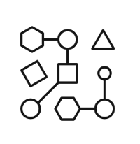

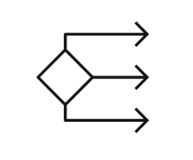


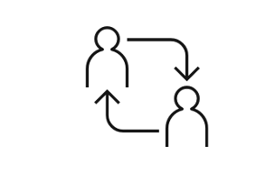
watsonx.ai – generative AI with traditional AI features
Train, validate, tune, and deploy AI models with confidence
Generative AI capabilities
Plus, a proven studio for machine learning
Foundation model library
ModelOps
Prompt lab
Automated development
Tuning studio
Decision optimization
Team collaboration and data preparation
Notes:
Watsonx.ai is part of the IBM watsonx platform that provides foundation models (FMs) and generative AI capabilities, plus traditional AI and machine learning modelling that clients have come to know (in IBM Watson Studio and IBM Watson Machine Learning).
These are the components in watsonx.ai:
The generative AI capabilities in watsonx.ai include the following:
Foundation model library – Includes many well-known models such as Generative Pre-trained transformer (GPT), Fine-tuned Language Net (FLAN), and more, as well as IBM’s own foundation models. Many of the models have been rebuilt on IBM’s data sets to reduce model sizes, mitigate problems (such as bias) and other common risks.
Prompt lab – Prompt engineering is a way of helping FMs become more accurate and precise in their response by providing some user interaction (called prompts). Prompt engineering is an “art” and requires practice. IBM provides samples of prompts and prompt templates, and the studio helps users to try different prompts and different models to get the best results.
Tuning studio – there are multiple ways that watsonx.ai lets clients fine-tune FMs:
Providing additional data to further train the model
Changing various runtime parameters such as
Number of virtual tokens
Batch size
Gradient accumulation steps
Learning rate
Max input/output tokens
Number of epochs
These parameters can alter the amount of time (resource) required to train the model when prompt tuning.
Plus a proven studio for machine learning (ML)
Clients continue to have access to familiar features from IBM Watson Studio in watsonx.ai such as
Model operations: training, deploying, managing, and more
Automated development
Decision optimization
In addition, team collaboration and data preparation is available for all models.

Slide 16

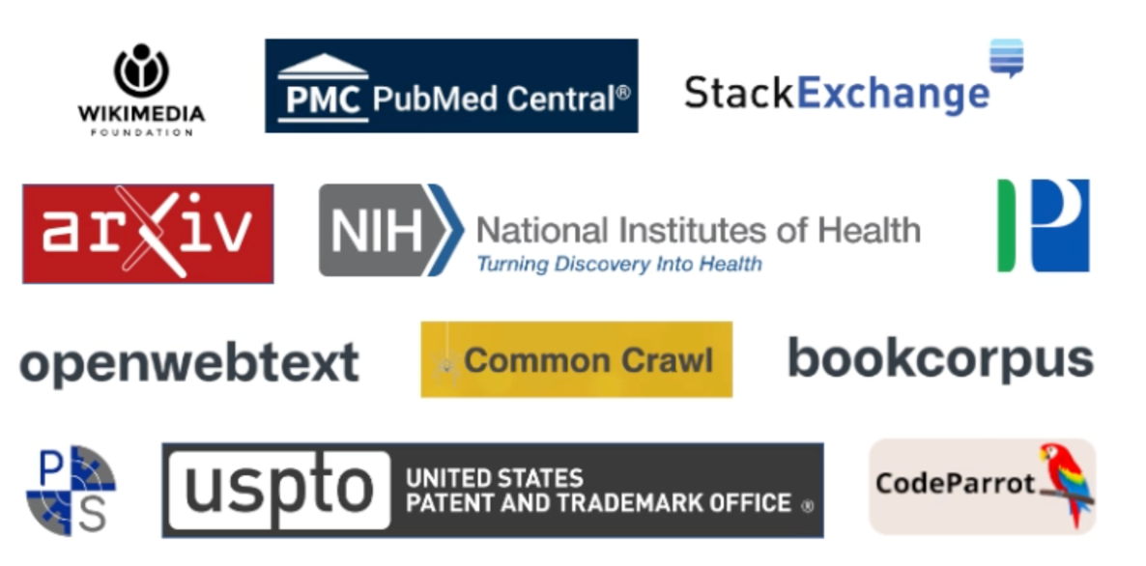
watsonx.data: curated IBM Data Pile Enterprise-ready data acquisition, curation, provenance, and governance
External Datasets
Data collection and extraction
Data Deduplication
Data Annotation
Data Filtering
Tokenization
IBM Internal Datasets
Document id generation
Exact dedup
Fuzzy dedup (threshold)
Sentence splitting
Language detection
Hate, abuse, profanity filter
Document quality
URL blocking
License detection (for code)
FM training
Customer
Datasets
Tuning and Customization
Dataset Acquisition
Dataset Preprocessing (model neutral)
Data Preprocessing (model specific)
Notes:
A very important factor for quality generative AI models is the set of data used to train the foundation model. Random, non-curated data sets could (and are likely to) introduce biased, inappropriate, illegal (such as copyrighted material), and simply wrong input for the models.
One of the strengths of watsonx.ai is the quality of the data used to train IBM’s foundation models. The contents of the data IBM used to train its models consist of curated data (listed below from the largest source to the smallest):
Internet
Code
Legal
News
Patents
Academic
Finance
Data used in IBM-trained foundation models will go through two main steps:
Data deduplication (where document id is also generated)
Data annotation – where cleansing/curating takes place, which includes actions such as:
Language detection
Hate, abuse, and profanity (HAP) contents are filtered out
Document quality checked
URL blocking
License detection (for code) to ensure only appropriate contents are used
Data is thoroughly filtered before it is used by watsonx.ai.
With this method, clients can still provide their own curated data set. Clients can be sure that all data sets going into the watsonx.ai model building have been curated.
Watsonx.ai provides IBM proprietary foundation models:
Unlike datasets used by various publicly available large language models to train, IBM uses enterprise-focused data collections that are:
Curated (to limit intellectual properties and bias issues)
Transparent
Optimized

Slide 17





watsonx.ai Foundation Model Library
Model variety to cover enterprise use cases and compliance requirements
IBM models
Opensource models
Experiment with open source models
IBM and Hugging Face partnership demonstrates our shared commitment to delivering to clients an open ecosystem approach that allows them to define the best models for their business needs.
IBM’s suite of foundation models is designed to ensure model trust and efficiency in business applications. Our suite of models features:
Transparent Pre-Training on IBM’s trusted Data Lake
One of the largest repositories of enterprise-relevant training data
Verified legal and safety reviews by IBM
Full, auditable data lineage available for any IBM Model
Compute-Optimal Model Training and Architectures
Granite Decoder only transformers
Slate Encoder only transformers
Sandstone Encoder-decoder transformers
Efficient Domain and Task Specialization
Models Coming Soon:
Finance
Cybersecurity
Legal, etc.
Bring-your-own-model
Optional add-on for more flexibility
Partner with IBM Research to pre-train your own foundation models.
Notes:
IBM watsonx.ai provides the best of both worlds.
IBM models
Foundation models like ChatGPT are “black” (opaque) boxes and that is one big reason why trust is difficult to achieve with these kind of models. IBM’s models are designed to address this gap to ensure model trust and efficiency in business applications. In particular, IBM’s suite of models features:
Transparent pre-training on trusted data One of the most important trust factors for models is the data that is used to train the model. There are 2 main issues: the quality of the data and the relevance of the data. Having random data from an internet crawl will likely inject bias, hate, and prejudice into the model. Whereas just using any data can bloat the model with parameters that may never be used. IBM has collected the largest known repository for enterprise-relevant training data covering a variety of topics like legal, finance, human resources (HR), and more. This data was then further cleansed and curated (remove duplicates, filter out bias, copyrights, etc.) to create a base pool of data used to build IBM’s model. IBM models have fully auditable data lineage and transparency – allowing clients to use them out of the box with trust.
Compute-optimal model training and architecture Using the trusted data, IBM is building different models that can be applied in different scenarios, some of which include:
Granite series models – are decoder-only transformers and are great for generative tasks such as generating emails and marketing materials.
Slate series models – are encoder-only transformers – smaller and compact but are better for non-generative use cases such as extracting and summarization and may require task-specific labeled data to fine-tune.
Sandstone series models – are encoder-decoder transformers supporting both generative and non-generative use cases. These have the best cost performance trade-off for generative use cases when the input is large but generated output is small.
Efficient domain and task specialization IBM provides domain-specific models where they are pre-trained with specific relevant data. This allows the model size to be minimized with focused pre-training for specific domain use cases such as finance, cybersecurity, legal, etc.
Open-source model IBM has a partnership with Hugging Face to provide access to open-source models to clients. IBM will work jointly with Hugging Face and surface the best models suited to clients’ business needs.

Slide 18
Foundation model libraries
Encoder
Decoder
Encoder-decoder
Powers search engines and customer-service chatbots, including IBM Watson Assistant.
Encoder-only models are widely used for non-generative tasks like classifying customer feedback and extracting information from long documents.
Encoders are not trained to predict, but rather to find & extract useful information from models trained with relatively smaller sets of data.
Google’s Bidirectional Encoder Representation from Transformer (BERT) is an example
Trained to predict the next word without an encoded representation.
Decoder-only models are used with chat platforms like ChatGPT to generate new responses, answers, or text based on simple input from customers.
Decoders are trained for predictive, generative tasks based on their massive pre-trained data sets.
The Generative Pre-Trained Transformer (GPT) is an example
Combines features of both encoder and decoder models.
They can do many of the generative tasks that decoder-only models can, but their compact size makes them faster and cheaper to tune and serve.
Google’s Text-to-Text Transfer Transformer (T5) is an example.
IBM watsonx.ai provides open
foundation models as well as IBM’s securely trained models including encoder, decoder, & encoder-decoder foundation models.
Notes:
IBM watsonx.ai foundation model library provides access to a variety of foundation models (IBM and open-source). Foundation models have different architectures.
There are three main types of general availability (with more to come):
Encoder foundation model
These are foundation models that power search engines and customer-service chatbots. They are used for non-generative tasks (in the sense that they do not generate completely original responses, but rather take and often summarize information from its vast pool of data). In this sense, encoders are not trained to “predict” (for example: what is the most likely next word in a sequence), rather it is used to extract information. Customer care such as IBM Watson Assistant, are obvious use cases for this model architecture. Encoders are trained on large, but relatively smaller (than decoder model) data sets.
Decoder foundation model
These foundation models are trained to predict the “next word” without an encoded representation. ChatGPT is a good example. Decoder-only models are used to generate new and original responses, answers, or text based on simple input/prompts from customers. The nature of the decoder requires training on a massive set of data because it is used to support very general and diverse questions and queries.
Encoder-decoder foundation model
This model architecture combines features from both the encoder and decoder models. Encoder-decoder can perform many of the tasks that a decoder-only model can do. However, with encoder capability these models are more compact as the data is compressed from the input layer, reducing the dimensions. Because of this, it requires less compute power as well. An encoder-decoder model reduces storage costs and makes information transfer more efficient without sacrificing the details of the information. Google Text-to-Text Transfer Transformer (T5) model is an example of the encoder-decoder foundation model.
Watsonx.ai provides open foundation models as well as IBM’s securely trained encoder, decoder, and encoder-decoder foundation models.
Source:
What is generative AI Webpage: https://research.ibm.com/blog/what-is-generative-AI

Slide 19
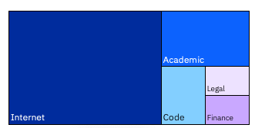
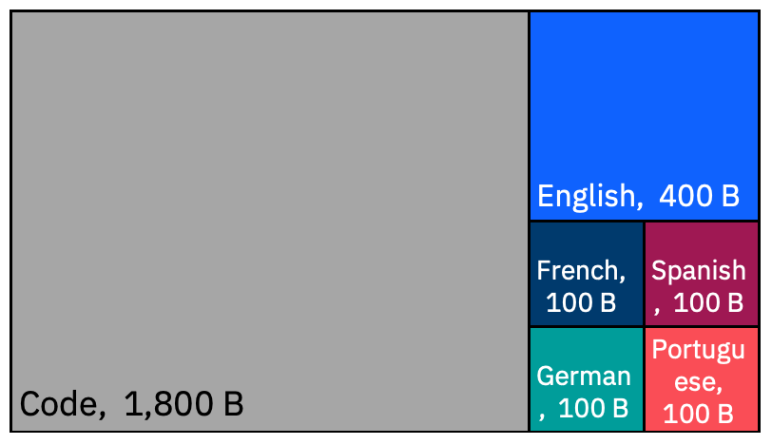
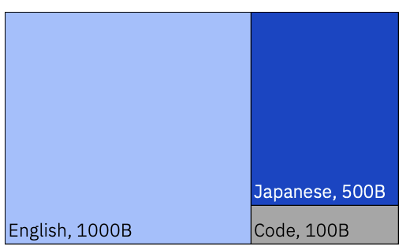
AI for business - IBM Granite
Granite is IBM's flagship series of LLM foundation models based on decoder-only transformer architecture.
Granite language models are trained on trusted enterprise data spanning internet, academic, code, legal and finance.
granite-13b-v2 ( English LLM ) -chat-v2.1, -instruct-v2
granite-20b-multilingual
granite-8b-japanese
13B parameters in size 2.5T tokens of data
20B parameters in size 2.6 T tokens of Data
8B parameters in size 1.6T tokens of Data
Notes:
Introduction to Granite Models
Granite models are advanced AI models developed by IBM Research. They utilize generative AI to excel in specialized business-domain tasks such as summarization, question-answering, and classification. They are built on a "decoder" architecture which is designed to predict the next word in a sequence without requiring knowledge of the entire sentence. This architecture is considered uni-directional, enhancing efficiency in natural language understanding tasks. The granite model comes in different forms and sizes, recognizing that a single model will not fit the unique needs of every business use case.
With these models and watsonx, IBM enables businesses to be AI value creators. Businesses can bring their proprietary data to IBM base models and build a model that is unique to their business and use cases.
Datasets the Granite model has been trained on
Granite models have been trained on diverse business-relevant datasets from five domains: Internet, Academic, Code, Legal, and Finance specifically:
Internet — Generic unstructured language data taken from the public internet
Academic — Technical unstructured language data, focussed on science and technology
Code — Unstructured code data sets covering a variety of coding languages
Legal — Enterprise-relevant unstructured language data taken from legal opinions and other public findings
Finance — Enterprise-relevant unstructured data taken from publicly posted financial documents and reports
The Granite model has three variants:
granite-13b-v2 ( English LLM ): This model has 13 billion parameters and is trained on 2.5T tokens of data.
-chat-v2.1: Chat derivative model is optimized for dialogue use cases and works well with virtual agent and chat applications.​
-instruct-v2: Instruct derivative model was designed to perform well on natural language tasks and can be customized for specific industries and domains via prompt-tuning.
granite-20b-multilingual: This model has 20 billion parameters and is trained on 2.6T tokens of data. This model provides support for English, French, Spanish, German and Portugese.
granite-8b-Japanese: This model has 8 billion parameters and is trained on 1.6T tokens of data. This model supports Japanese. Note – this model is only available in the Tokyo data centers.

Slide 20
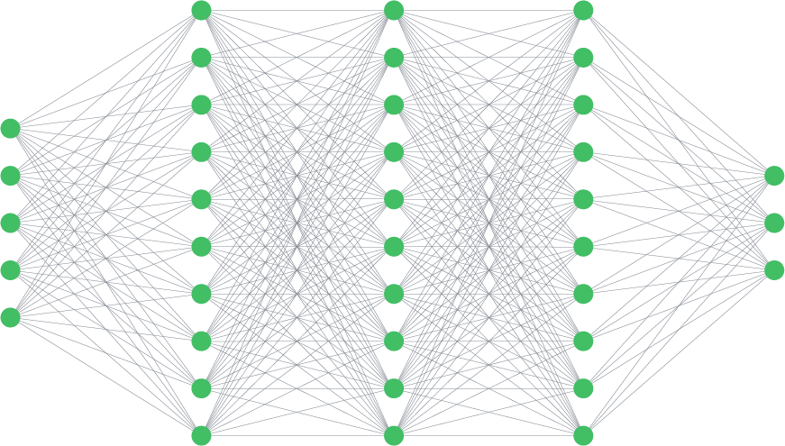
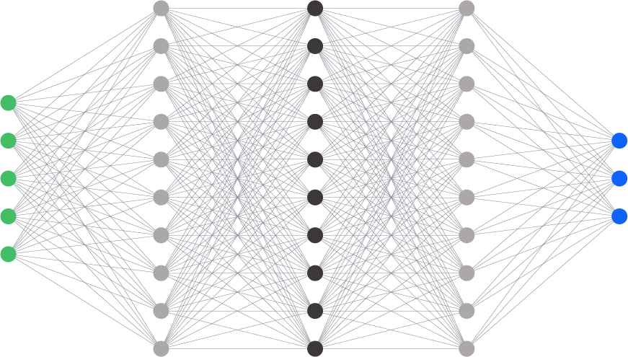


Rapid adaptation to multiple tasks with small amounts of task-specific data
Fine-tuning requires labeled data and more resources to tune the model. When a model is fine-tuned, some of the weights are modified and clients get a private instance of the model.
Increasing complexity and skills
Requires increasing model size
Task A
Fine-tuning
Roadmap item
In prompt tuning, labeled
client data is passed in.
Prompt-tuning
Task B
Tuning Studio
In prompt engineering or prompt tuning, the model is not changed.
Prompt engineering
Foundation model
Task C
Prompt Lab
Notes:
There are different ways to work with foundation models. Clients will find that in many cases, their models perform quite well out of the box. Foundation models can be adapted quite easily to new use cases. However, there will be times when foundation models need some adjustments to really fit in with specific use cases – especially when clients have their specific languages/terminologies and have their unique way of organizing their data.
There are two main types of training:
At the prompt level (where none of the model’s weights are changed) - prompt engineering and prompt tuning
Prompt engineering – clients modify what is passed into the model (the prompt) so the model is better able to understand the requirement of the task at hand.
Prompt tuning – takes this one step further. Instead of changing the prompt, clients will pass in a set of labeled data. This is like using a “few-shot” prompt where ”few” means up to hundreds (instead of single digit) of input/output example. This provides some data specific to the client that is passed to the model to help it attune itself to the client’s domain. This does not change any model weights; however, it requires more work from the client to provide the labeled data and is more expensive to run/test.
At the model level – fine-tuning: this involves passing in a larger set of labeled data as well as allowing the model weights to be changed. The result is a modified instance of the model that a client owns. This requires access to a larger resource pool to rebuilds parts of the model. This tuning method results in the best performance (accuracy) as clients can train their model with very specific data from the business to very specific use cases. In addition, the data required to fine-tune a model is only a fraction of what it would take with a traditional AI model. If clients have fine-tuning in mind, they typically start with a smaller foundation model. This helps to control the cost of building and running the model.
Watsonx.ai provides:
Prompt Lab – for prompt engineering, this includes examples as well as prompt history.
Tuning Studio – for prompt tuning and fine-tuning. The studio provides a workflow for the clients to tune the prompt or model
The 2 arrows on the extreme right of this slide provide a quick contrast between the complexity of skills required for training (prompt engineering is easiest, while fine-tuning is most difficult) and the size of the model required for good results. Prompt engineering requires the least amount of training so generally requires a larger model for similar results as a fine-tuned model.

Slide 21
watsonx.ai
Prompt engineering
Prompt tuning
Benefits to clients:
There is no change to the model (no need for an expensive rebuild)
No need to pass in labeled data
Much faster way of training the prompt to properly respond to requests
Can be passed in via APIs once a prompt has been properly engineered
Can be used by anyone to guide the model to respond in a desirable way
Benefits to clients
There is no change to the model (no need for an expensive rebuild)
Requires labeled data but can achieve better performance even with using a smaller size model.
Can achieve close to fine-tuning results without model modification
Can be passed in via API
Can be used by anyone to work with the model
Notes:
This slide describes the high-level differences between prompt engineering and prompt tuning.
Neither prompt engineering nor prompt tuning requires a change to the underlying foundation model – so it is not as expensive to run as fine-tuning a model which updates its weights. Both can used via application programming interface (API) and can be used by anyone with access to the model.
Prompt engineering is a lighter-weight and easier way to work with foundation models. Clients alter the prompt (and can include additional info to steer the model – this is referred to as “shots”) to instruct the model on how to respond. This is a natural language task and does not require any deep technical knowledge of the underlying model.
The main difference between prompt engineering and prompt tuning is that clients must pass in a set of labeled data with prompt tuning. This does mean a much larger set of tokens are being used (all models have a limit to the number of input tokens they can accept, so providing examples with prompt tuning consumes these tokens). With most models, this would mean it is more expensive. The advantage, however, is that clients can start with a smaller model (making it less expensive to run) and with a proper set of training data prompt tuning can achieve near-fine-tuning performance.

Slide 22
watsonx.ai
Foundation models are adaptable. One way to adapt the model is using prompt engineering.
What is prompt engineering?
Prompt engineering is a new discipline for finding the optimal prompt to use with a foundation model for the best performance.
Why is it important?
For most generative AI, it is not so much “answering” a question than simply appending the most likely text
Simply asking a straightforward question may not yield the best result
A prompt is a way to communicate with the foundation model to:
Pass additional instructions on how the model should respond
Feed task-specific context to the model
IBM watsonx.ai provides a Prompt Lab with an interactive prompt builder:
Includes prompt examples for various use cases
Clients can experiment with different prompts, save and reuse older prompts, use different models and vary different parameters
Prompt Engineering
Prompt engineering is an art – and watsonx.ai Prompt Lab provides a rich and guided learning experience.
Notes:
This slide covers prompt engineering and prompt tuning in some detail.
Prompt engineering is available through the watsonx.ai Prompt Lab which helps clients to test out different prompts to get the best results. Clients can try zero-shot, one-shot, or few-shot prompting (more detail below).
How to use prompts to get the best answer?
Foundation models can be “instructed” to solve various natural language processing (NLP) tasks through a process called “prompt engineering” (sometimes referred to as instruction promoting). Prompt engineering is a process of designing, creating, and testing prompts for natural language generation (NLG) systems. Specifically, prompt engineering (also known as In-Context Prompting), refers to methods for how to communicate with large language models (LLMs) to steer their behavior for desired outcomes without updating the model weights. At its core, the goal of prompt engineering is about alignment and model steerability. It’s important to appreciate the term steerability… with prompt engineering, the underlying model is not changed.
Why is it important?
Generative AI is generating the next words/phrases based on what users have inputted (prompted). It is not “answering”, it cannot read beyond the words into the intent like a human would. It needs to be instructed properly to return the information desired.
A prompt is a way to communicate with the foundation model to:
Pass additional instructions on how the model should respond
Feed task-specific context to the model
Finding the right prompt is an art and requires experience. Watsonx.ai comes with a Prompt Lab which has an example library and interactive prompt building for clients to try out different prompts and find the best one.
There are various types of prompts, for example the following:
Zero-shot prompting - refers to general foundation model interaction with no specific instructions or specific data set to learn from. It just absorbs everything. Even with zero-shot, a very large model can reasonably perform in many use cases. An example would be just typing in the following question: “Question: What is Maximo?”
One-shot or few-shot prompting - refers to the case where users provide additional training data (this can be clarification, examples) to a model so it learns to understand what users are looking for. These provide further instructions for the model. As these types of input are given at the time of query, they can be very specific to the task at hand and so can be quite effective to help the model to understand what is required. Prompt tuning, however, is more an art than a science. A 2-shot prompting example (based on the one above) can be: “Question: What is Watson Studio”, “Answer: Watson Studio is IBM’s Integrated Development Environment to build, run and manage AI models” “Question: What is Db2?”, ”Answer: Db2 is a family of database management systems to run clients’ mission-critical workloads” “Question: What is Maximo?” The first 2 questions represent the 2-shot prompting – by giving 2 examples of what type of answer is expected.
Clients can also save and use older prompts, or change the prompts using different parameters.

Slide 23
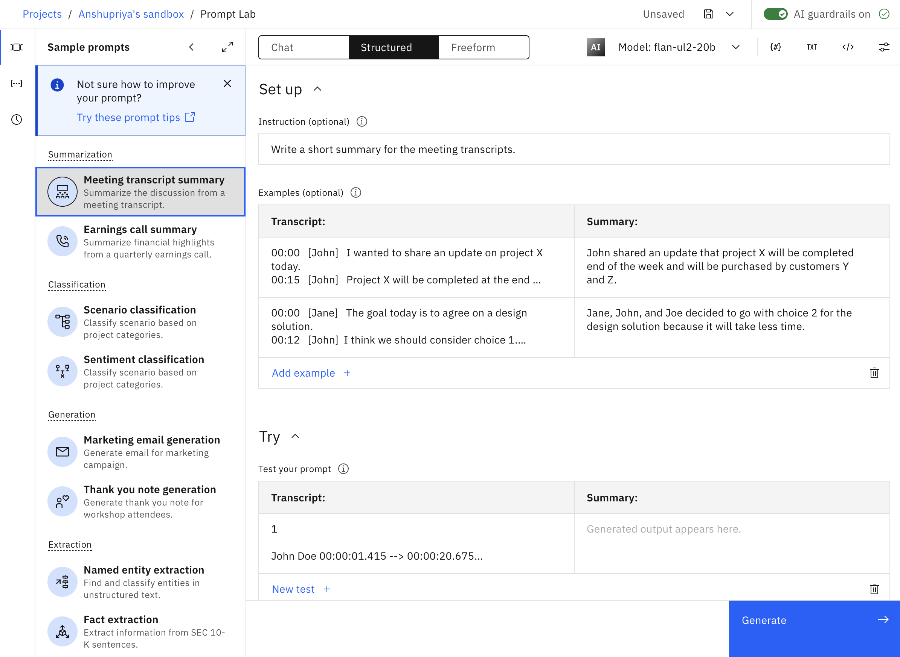
watsonx.ai: Prompt Lab
Experiment with foundation models and build prompts
Interactive prompt builder
Experiment with prompt engineering
Includes prompt examples for various use cases and tasks
Experiment with different prompts, save and reuse older prompts, use different models and vary different parameters
Experiment with zero-shot, one-shot, or few-shot prompting to get the best results
Choice of foundation models to use based on task requirements
Prevent the model from generating repeating phrases
Number of min. and max. new tokens in the response
Stop sequences – specifies sequences whose appearances should stop the model
Notes:
This self-explanatory slide describes the features available from the watsonx.ai prompt lab. Clients can work with the Prompt Lab in many ways.
A prompt is a way for clients to interact and instruct foundation models to provide answers. In generative AI, the model is not “answering” but is “generating” a response based on input and what it has been trained on. How one “prompts” the model can bring very different results. Prompt engineering is the “art” of prompting in ways that a model can best understand and respond to client requests.
The Prompt Lab is a part of the watsonx.ai user interface (UI) that allows users to perform prompt engineering, and experiment with different prompts across different foundation models.
Experienced clients can select the model of interest and experiment with different prompts to see what works best for a particular model. Clients can try different “shots” with prompts:
Zero-shot prompting – simply passing a request into the model without additional information. Some models (larger ones) will respond better than others, depending on the request.
Clients can learn to provide simple input to orient the model properly to the user’s intention to provide the best answer.
Less experienced users can select different prompt samples from the Prompt Lab and learn how the examples utilize one-shot or few-shot tuning.
One-shot prompting - One-shot prompting involves giving an AI a single example to guide its response
Few-shot prompting - Few-shot prompting provides a few examples, helping the AI understand the context or task better.
Clients can set various parameters such as:
Greedy vs Sampling – with ”Greedy” the word/token with the highest probability is selected. Most large language models (LLMs) operate this way, it is the simplest form of next-word prediction. In sampling, the model selects a token using a random-weighted strategy across the probabilities of all tokens, resulting in the possibility of returning a less probable answer. This is used for creativity and to avoid repeating words but can cause the LLM to “wander” into other areas.
Sampling parameters include:
Temperature – in general, the higher the temperature the higher the randomness. Setting the temperature to 0 means the model will always return exactly the same result (it will be deterministic). A higher temperature allows the model to consider other probabilities (non-deterministic) and cause hallucinations.
Top P – use this to limit random sampling to predictions whose combined probabilities do not exceed the threshold (value of P). A Top P value of 1 means everything is considered. A lower Top P value weeds out the lower probability options.
Top K – let the model select from the top K results only.
Repetition penalty – to prevent the model from generating repeating phrases
Stop sequences - tell the model to stop generating any more output once it encounters the specified stop sequence.
Min./max. new tokens – the minimum or maximum new tokens used in the response – controlling how “verbose” the response should be.
Note that, unlike traditional AI tasks, generative AI creates a response best suited to its understanding of the question. This requires experience on the user’s part to learn how to effectively prompt the model as it needs to understand enough of the intent of the request. Using the prompt lab develops this experience.
The best way to learn how to pass good prompts is by example. The watsonx.ai prompt lab provides many examples of various natural language processing (NLP) tasks such as:
Summarization
Extraction
Generation
Classification
And more …
IBM watsonx.ai prompt lab keeps a history of prompts. As part of learning, users may want to go back to previous prompts what might have worked better or to tweak them differently. The user interface keeps track of past prompts and users can easily move back and forth.
Once a data scientist/engineer has found the best prompt, it can be passed in via an application programming interface (API) or Python notebook to the model. It can be used to automate tasks for other users.
While clients can prompt tune or fine-tune their models, that requires work and resources. Prompt engineering is a way to evolve a model for the needs of the clients without model rebuilding or a lot of labeled data.

Slide 24
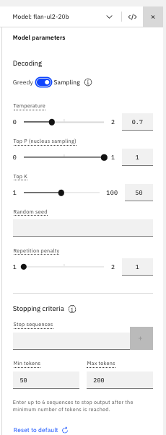
watsonx.ai: Prompt Lab
The Prompt Lab allows other modifications on various parameters such as:
Choice of foundation models to use – some are better at certain tasks than others
Types of decoding used – the process the model uses to generate the output
Repetition penalty – prevent the model from generating repeating phrases
Stop sequences – specifies sequences whose appearances should stop the model
Number of min and max new tokens – specifies boundaries of the number of tokens in the response
Parameters for prompt engineering
Notes:
There are various types of prompts, for example the following:
IBM watsonx.ai supports prompt engineering with an easy-to-use interface (called the Prompt Lab). The Prompt Lab provides examples of some typical requests. Clients can easily modify or put in their own prompts using its simple interface. Clients can always move back and forth to an earlier prompt and can also save their best prompts for later use or reference.
Beyond adding prompts/inputs, clients also have the choice to modify some parameters that affect how the model operates. These can vary depending on the model and may include the following:
Choice of foundation models to use - some are better at certain tasks than others
Types of decoding - Clients can choose between Greedy vs Sampling – with ”greedy” the word/token with the highest probability is selected. Most Large Language Models (LLMs) operate this way, it is the simplest form of next-word prediction. In sampling, the model selects a token using a random-weighted strategy across the probabilities of all tokens, resulting in the possibility of returning a less probable answer. This is used for creativity and to avoid repeating words but can cause the LLM to “wander” into other areas.
Sampling parameters
Temperature – in general, the higher the temperature the higher the randomness. Setting the temperature to 0 means the model will always return exactly the same result. A higher temperature allows the model to consider other probabilities and cause hallucinations.
Top P – use this to limit random sampling to predictions whose combined probabilities do not exceed the threshold (value of P). A Top P value of 1 means everything is considered. A lower Top P value weeds out the lower probability options.
Top K – let the model select from the top K results only.
Repetition penalty – to prevent the model from generating repeating phrases
Stop sequences - tell the model to stop generating any more output once it encounters the specified stop sequence.
Min/Max new tokens – the minimum or maximum new tokens used in the response – controlling how “verbose” the response should be.
The Prompt Lab is great for performing simple zero-shot to few-shot prompting. In many cases, this may be enough. However, enterprises also have the option to provide specific training data to a model using the watsonx.ai tuning studio.

Slide 25
watsonx.ai
Prompt Lab: email generation
Append prompt with additional context
Prompt: Write a thank you note for attending a workshop.
Attendees: Enterprise clients
Topic: Introduction to IBM watsonx
Tone: Appreciative
Output:
We would like to thank all the attendees that came out and participated in today's introduction to watsonx workshop. It was a great turnout, and you are making an impact by engaging your enterprise with Watson. Thank you for taking the time, spending the day, and sharing your experience with it. We hope that you enjoyed the workshop and learned something new. If you have any questions about watsonx, just let me know!
Prompt: Write a thank you note for attending a workshop.
Attendees: Enterprise clients
Topic: Introduction to IBM watsonx
Tone: Appreciative
Expectation: discuss business opportunities
Output:
We would like to thank you for taking the time to attend our workshop today. It was a great day, and we are pleased that you were able to participate. This is an exciting time for Watson Health as we continue to expand our capabilities in clinical care, cognitive computing, analytics and mobile technology. As IBM watsonx continues to expand, we hope that you will reach out to us with questions or concerns regarding the product. In addition, we welcome feedback on how we can improve your experience with watsonx. Thank you again
Notes:
This self-explanatory slide shows an example of a prompt and prompt-tuning.
On the left side of the slide is a simple prompt asking the model to write a thank-you note. The model does a pretty good job of it. However, a thank-you note should include an invitation for the next step. On the right side of the slide, the client adds the phrase “Expectation: discuss business opportunities” to the prompt, the model figures out what is required and provides a modified email that provides the needed content.
Through this exercise, clients learn that they can pass in tokens with ”Expectation” to get the model to provide additional content. This can subsequently be used (via an application programming interface (API) calls with different values) to create emails with desirable content.
Source:
What is prompt tuning? Webpage: https://research.ibm.com/blog/what-is-ai-prompt-tuning

Slide 26
watsonx.ai
Prompt Lab: client complaint
The following paragraph is a consumer complaint. The complaint is about one of these options: credit cards, credit reporting, mortgages and loans, retail banking, or debt collection. Read the following paragraph and list all the issues.
I called your helpdesk multiple times and every time I waited 10-15 minutes before I gave up. The first time I got through, the line got cut suddenly and I had to call back. This is just ridiculous. When I finally got through like after 3 days (yes, 3 days) your agent kept going over a long checklist of trivial things and asking me to verify, after I repeatedly told the agent that I am an experienced user and I know what I am doing. It was a complete waste of time. After like an eternity of this pointless conversation, I was told that an SME will contact me. That – was 2 days ago. What is the problem with your support system?
In this example, a modified prompt with an example is provided to the model to teach it what is expected.
I bought a GPS from your store and the instructions included are in Spanish, not English. I have to use Google Translate to figure out. The mounting bracket was broken, and so I need information on how to get a replacement. Moreover, the information seems to be outdated because I cannot see the new roads put in around my house within the last 12 months.
The list of issues is as follows:
1) The instructions are in Spanish, not English.
2) The mounting bracket is broken.
3) The information is outdated.
Retail banking
The next page shows the new output with this additional “one shot” input.
Notes:
This self-explanatory slide shows an example of prompt engineering for a customer complaint information extraction task.
On the left side of the slide, initial instruction was given asking the model to list all the issues from an irate customer complaint. Without the training, the model attempts to complete the tasks by guessing which of the options is likely to have these complaints and concluded that the issue relates to retail banking; however, this is not what the question is asking for.
In this example, the modified prompt is in the form of an example being passed into the model (this is a one-shot prompting). The example (highlighted by a grey box on the right side of the slide) provides one similar complaint and the expected output, which is a list of issues that came from the input text. This is teaching the model that this query is not asking for the best-match option from the complaint, but rather a list of specific issues raised. The next slide shows what the model will now do with the new prompt.

Slide 27
watsonx.ai
Prompt Lab: client complaint continue
With the added instructions from the previous slide, this is the new output: The list of issues are as follows;
Waited 10-15 minutes every time I called
The line got cut suddenly
The agent kept going over a long checklist of trivial things
I was told that an SME will contact me
No one called
The following paragraph is a consumer complaint. The complaint is about one of these options: credit cards, credit reporting, mortgages and loans, retail banking, or debt collection. Read the following paragraph and list all the issues.
I called your helpdesk multiple times and every time I waited 10-15 minutes before I gave up. The first time I got through, the line got cut suddenly and I had to call back. This is just ridiculous. When I finally got through like after 3 days (yes, 3 days) your agent kept going over a long checklist of trivial things and asking me to verify, after I repeatedly told the agent that I am an experienced user and I know what I am doing. It was a complete waste of time. After like an eternity of this pointless conversation, I was told that an SME will contact me. That – was 2 days ago. What is the problem with your support system?
This is the expected results.
With the added instructions, the model further understands that the task is to extract a list of issues raised by the customer.
Notes:
This self-explanatory slide is a continuation of the previous slide showing how prompt engineering works.
On the left side of the slide is the same question (after a sample Question-and-Answer pair is passed in).
Running the query again, the model successfully produced the list of issues from the complaint text (shown on the right side of the slide).

Slide 28
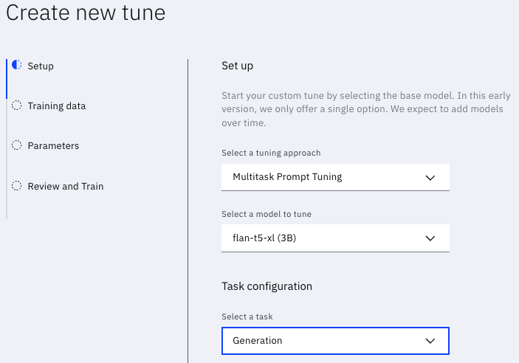
watsonx.ai: Tuning Studio Tune your foundation models with labeled data
Another useful feature of watsonx.ai is the prompt tuning in the tuning studio.
Watsonx.ai allows clients to further tune the prompts
Unlike prompt engineering, prompt tuning allows clients to further train a model with focused, business data.
In prompt tuning, the underlying model is not changed.
The input prompt is changed via augmenting input with examples.
Notes:
Beyond prompt engineering (manually adjusting the prompt sent to a pre-trained model to get a better answer), clients may want to feed a small set of labeled data to update the foundation model to better serve specific needs. With watsonx.ai, clients can supply their set of data to train a foundation model. These trained models belong to the clients and are for their use only.
With the Tuning Studio, clients can perform prompt tuning. Prompt tuning takes the next step beyond simple prompt engineering (which involves modifying how a request is passed into the foundation model). Specifically:
Name the finished model – clients can create their own naming convention for models that they wish to tune for different purposes or track the usage of different base models
Select the models they want to tune. Foundation models are different because the training method/process and the underlying data, and the number of parameters used, are different. Certain foundation models are better suited to certain types of tasks. Clients can start with one that’s already performing well for their desired tasks and make it easier and faster to tune.
Easily drag-and-drop to provide their own training data. This data can be in JSONL (JSON lines) or JSON format and clients can simply point at a directory where the files are or drag and drop it into the studio.
Example of a JSONL file:
{"input":"<text>","output":"<text>"}
{"input":"<text>","output":"<text>"}
{"input":"<text>","output":"<text>"}

Slide 29
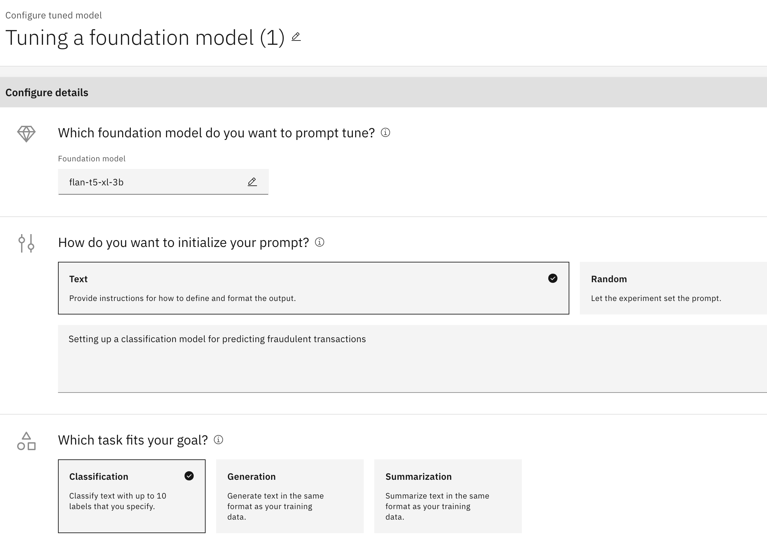
watsonx.ai: Tuning Studio
Prompt tuning
Task support in the Tuning Studio
Efficient, low-cost way of adapting an AI foundation model to new downstream tasks
Tune the prompts with no changes to the underlying base model or weights
Unlike prompt engineering, prompt tuning allows clients to further enhance the model with focused, business data
Models support a range of Language Tasks: Q&A, Generate, Extract, Summarize, Classify
Requires a small set of labelled data to perform specialized tasks
Can achieve close to fine-tuning results without model modification, at a lower cost to run
Notes:
The Tuning Studio allows clients to try out prompt-tuning and fine-tuning.
With prompt tuning, clients can choose a model and use their own specific data to enhance that model. While foundation models are very capable at a general level, businesses have their business terminologies, specific workflow, and specific output that they expect from queries. In prompt-tuning, clients can feed a set of <input query>-<expected output> pairs into the model. This teaches the model to better understand the intent of specific questions and how to generate the most relevant output.
As clients pass data into their model, there are also parameters they can modify to enhance the model. Keep in mind that this (depending on the model) can be a very involved and resource expensive process. Clients can consider using larger batch_size (number of samples to work through before modifying any internal parameters) and smaller num_epochs (number of times to cycle through the sample data) to control training time/cost.
There are two important things to note with prompt tuning:
No model weights are changed with the process. Clients are enhancing the model, but the original parameter weights can be kept intact.
With the proper set of data, this can achieve near-fine-tuning results. This is important – while fine-tuning a model may give the best results, it is much more expensive as the model is updated (the bigger the model is originally, the more expensive it is). Prompt tuning also avoids catastrophic forgetting (for example, the underlying model has so much of the weights modified it no longer resembles the original – this essentially destroys the reason why the base model was chosen in the first place).

Slide 30

IBM partnership with open- source models provider
IBM watsonx.ai clients have access to the latest and greatest open-source foundation models from Hugging Face.
The IBM and Hugging Face partnership demonstrates a joint commitment to deliver an open ecosystem to clients, allowing them to find the best foundation models for their business needs.
Notes:
Another advantage of IBM watsonx.ai is the partnership with Hugging Face – the leading open-source platform provider for machine learning models including generative AI models.
This partnership allows clients to access the latest and greatest open-source models from Hugging Face. It demonstrates IBM’s dedication to open-source and a commitment to making available the best of open-source. Clients can find and use the models that best fit their business needs.
Note that for best-fit clients should keep considering the following:
Look for models that can perform the task at hand
Among those models, a fine one with the right size can perform satisfactorily. Clients can always go with a huge model, but it will be much more expensive to run. Options are therefore important.

Slide 31
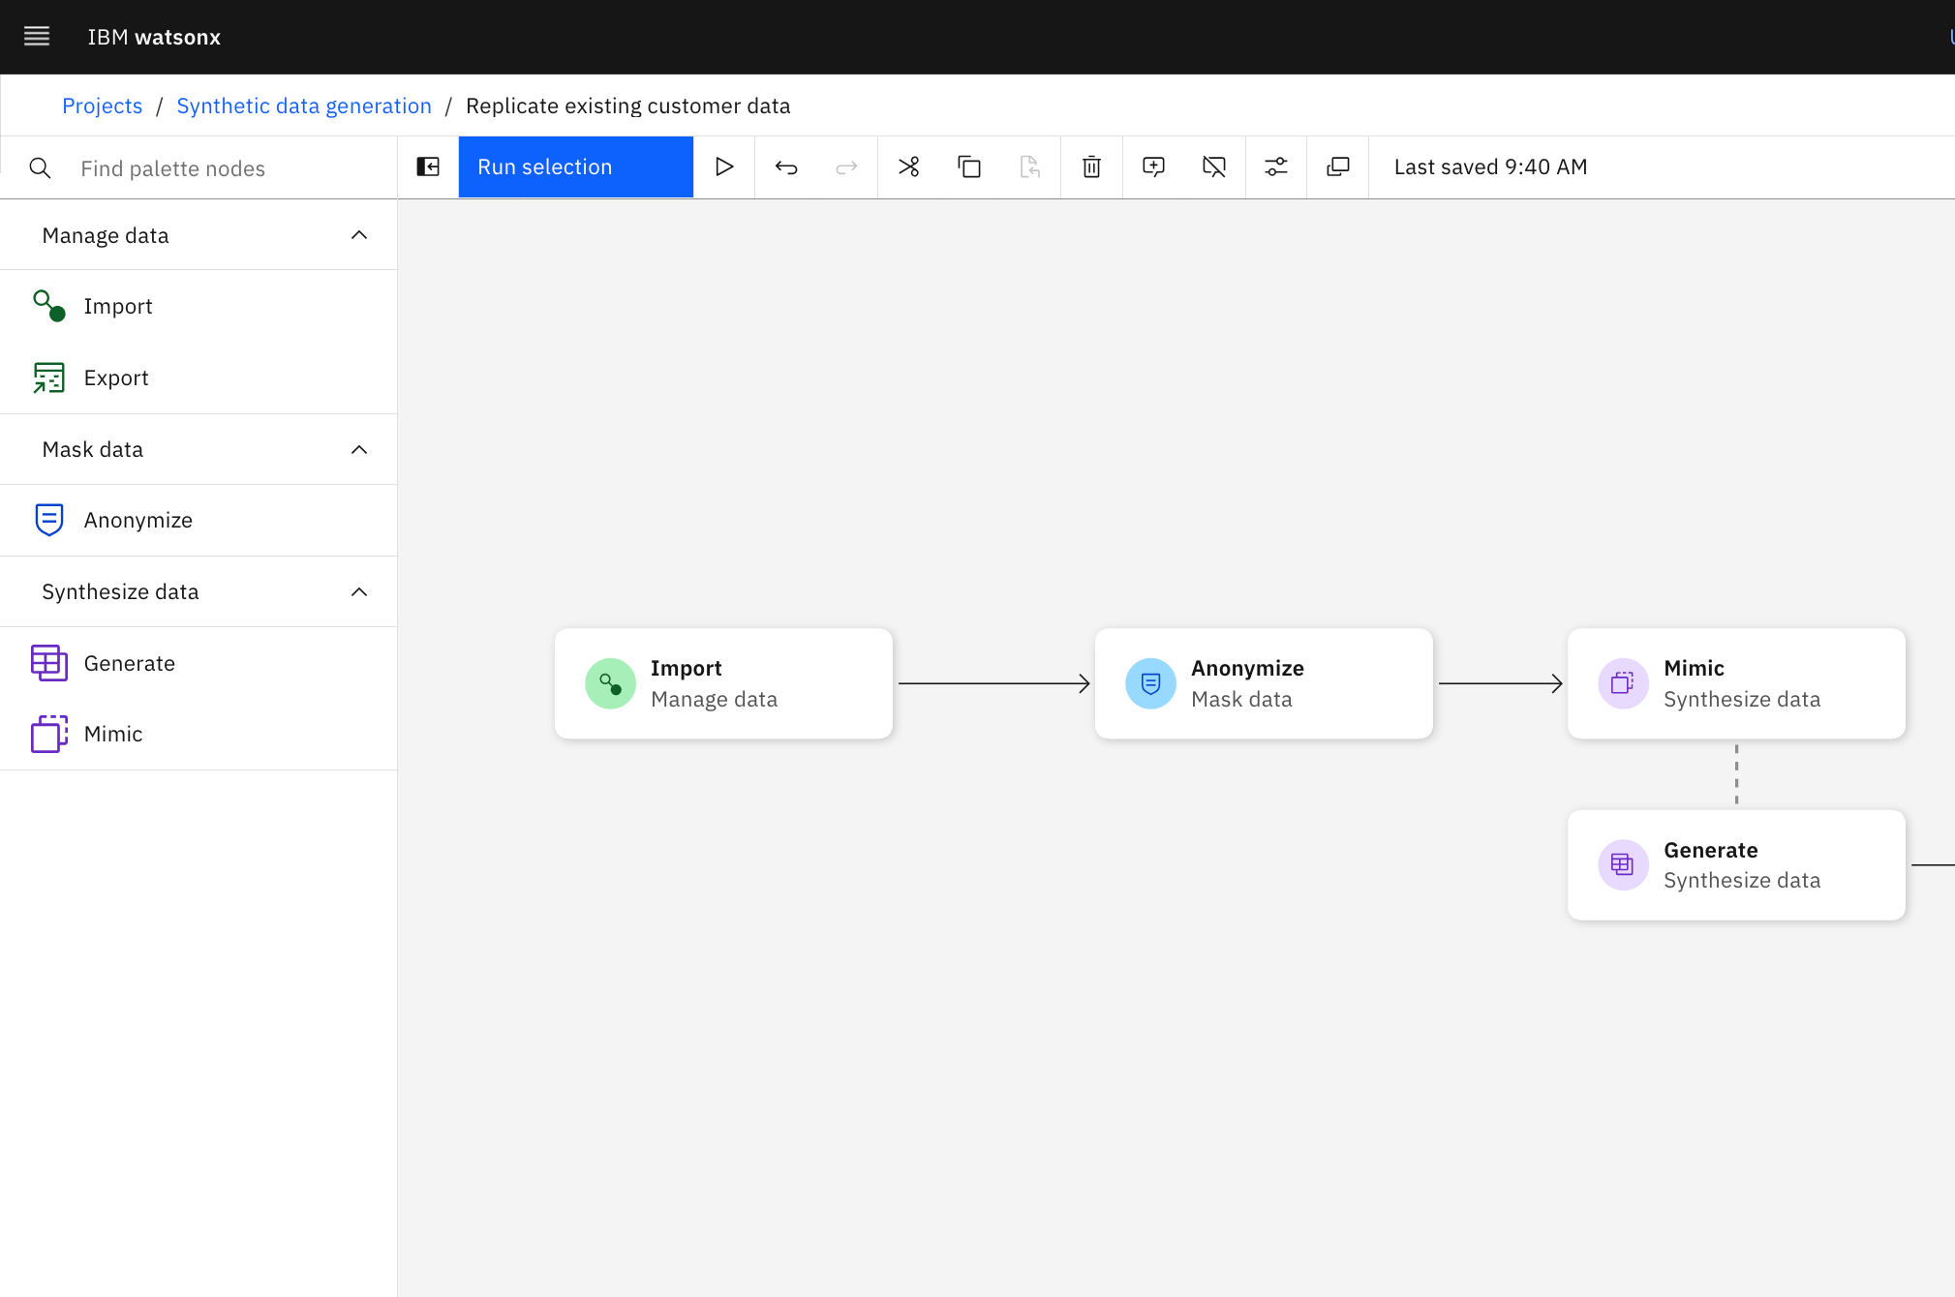
watsonx.ai: Synthetic Data Generator Generate synthetic tabular data to address your data gaps
Create synthetic data at scale
Select your model & privacy needs
Unlock your valuable insights by using synthetic data.
Create synthetic data using your existing data in a database or by uploading a file. If no data exists or can’t be accessed, you can design your own data schema.
Address data gaps and create synthetic edge cases to expedite classical AI model training.
Depending on your cost, fidelity, application, or data needs, you can select from multiple IBM models* to create your synthetic
tabular data.
When using existing data, IBM models apply differential privacy to minimize your privacy risk and give you control over the level of privacy protection required for your organization.
Notes:
There is tremendous value in the data that businesses collect, but access and availability to that sensitive data remain ongoing obstacles that impact speed-to-market, privacy risk, and overall ability to innovate. This influences what insights you can collect, how much data you can share, how much you spend on data, how many AI models you can deploy, how quickly you can do so, and how effective they are.
IBM watsonx.ai’s Synthetic Data Generator helps tackle this problem by enabling businesses to generate the synthetic tabular data they need, using existing data from a database or file or using a custom data schema. When using existing data, clients can use masking capabilities to remove/hide particular table columns prior to generating synthetic data, as well as the option to apply differential privacy to ensure minimal privacy risk.
Three IBM synthetic data generation models will be available: statistics-based, agent-based, and generative AI-based.
IBM model overview:
Statistics-based model – This model can generate synthetic data based on existing data or a custom data schema. Although not as accurate as a generative-AI model, it provides the quickest, most affordable way to approximate your real data since it leverages CPU vs GPU. This model is best suited for creating edge case data, additional data for AI model training, demo data, or data for internal training. Differential privacy will be available for this model in Q4 to ensure minimal privacy exposure.
Agent-based model – This model can ingest real data and new data schemas. This model is best suited for use cases where no existing data exists or is accessible, specifically better understanding “what-if” scenarios through agent-based simulations. This model leverages a combination of statistical models and business rules to create synthetic agents, which can represent cars, financial transactions, customers, products, patients, etc. This is a mature/advanced approach to data synthesis best suited for enterprises already familiar with and deploying synthetic data that are interested in adding another “tool” to their synthetic “toolbox”.
Generative AI model – This model can only ingest existing data. It is best suited for use cases that require high fidelity and differential privacy to mitigate privacy risk, such as internally extracting insights, sharing externally as a method to monetize, or generating more data to train classical AI models. This model leverages GPUs, so takes longer and is more expensive, but provides higher accuracy relative to statistical model and requires less domain expertise (thus, more line-of-business friendly).

Slide 32



watsonx.ai
Value propositions - Addressing the needs of different persona
Data Scientists
Data scientists leverage watsonx.ai to work with data, generative AI, and traditional machine learning (ML) to solve business problems.
Key responsibilities:
Data scientists help to figure out business problems and determine what data is applicable to solving those problems.
They sometimes retrieve and clean data.
They work with AI models to solve problems — creating traditional ML models, as well as working with foundation models to prompt engineers and tune models.
They sometimes deploy AI models and monitor their lifecycle.
Developers
Developers leverage watsonx.ai to work with foundation models and create prompts — enabling them to grab production-ready code they can put to use in an application.
Key responsibilities:
Developers develop and deploy software with high-quality and compliant code.
They automate processes with the use of generative AI to avoid repetitive and menial work.
Previously developers were not often able to work with ML, but generative AI enables developers to now work with foundation models.
Analysts
Analysts leverage watsonx.ai to work with generative AI to automate their workflow. They also ensure that AI models accurately generate outputs that reflect their specific domain.
Key responsibilities:
Analysts review generative AI model outputs to ensure that the foundation model is generating accurate responses relevant to the business context.
They use various tools to showcase and share reports, including AI tools that help automate their workflow.
Their reports cover actionable business insights that are guiding others in making decisions for their company.
They support others to assess the data available, understanding the existing processes, and resolving data issues.
watsonx.ai caters to different types of AI builders
Notes:
This self-explanatory slide shows some of the key personas that watsonx.ai caters to such as data scientists, developers, and analysts.
It must be pointed out that watsonx.ai does NOT stand alone. There is also watsonx.data and watsonx.governance which supports additional personas, such as:
CTO and security officers – it’s one thing to have available generative AI models, it’s another to be fully confident to trust the model given how well-documented these models can misbehave. Watsonx.ai can work with watsonx.governance to provide the type of control, transparency, and explainability that makes generative AI a winner.
Data analysts/business analysts – watsonx.ai provides generative AI models that can greatly enhance what data/business analysts can do with the data, or with their workflow. In turn, watsonx.data provides trusted, curated data for training the models, providing added confidence for how the models are updated.

Slide 33
watsonx.ai
Automation
IBM brings together AI, business process capability, and industry knowledge to support complex natural language interactions with users, process mining integrated with IT observability, and improved automation accuracy with governance, auditability, and trust.
.
Data
IBM watsonx.ai works closely with watsonx.data to provide a tightly integrated ecosystem:
watsonx.data provides governed data for model development and training
watsonx.ai provides generative AI models to analyze workloads
Works closely with other IBM technology pillars
Hybrid Cloud
Provide generative AI capabilities everywhere, on-premises or in the cloud. Aiming to dynamically discover, deploy, and compose infrastructure and services via scalable advances in AI, automation, and programming models.
Security
AI is used to create a unified security workflow across the multitude of security tools most companies need to manage and reduce incident response times. AI helps to protect data across the hybrid cloud and simplify compliance.
Notes:
Watsonx.ai is part of the new watsonx platform and they are designed to work together within the larger IBM software ecosystem.
Automation
Watsonx .ai brings the power of generative AI to improve automation accuracy with governance. In addition, its auditability provides trust in the process.
Data
AI and data have always worked very closely together. Watsonx.data and watsonx.ai are highlighted here but these relationships are not inclusive just between these two.
Watsonx.ai allows clients to tune it with their own data. However, that should be governed and curated data and not just anything arbitrary. Watsonx.data provides that capability, with access to data available in object storage that can be securely used to build models.
Enterprise generative AI is used to analyze all types of data to extract information (such as summarizing logs to highlight warnings and flags) – on various contents held in watsonx.data.
Hybrid Cloud
Watsonx.ai is built on top of Red Hat OpenShift so can be made available anywhere the clients need it. It provides generative AI to match clients’ business requirements – especially in regulatory compliance.
Security
Watsonx.ai has many applications in the security area. It creates a unified security workflow across the multitude of security tools most companies need to manage and reduce incident response times and protects data across the hybrid cloud and simplifies compliance.

Slide 34
watsonx.ai competitors
Multiple vendors are offering generative AI services. Here are some top competitors:
Hyperscalers
AWS (Bedrock)
Azure (Azure OpenAI Service)
Google Vertex (Generative AI Studio)
Nvidia *
Others
AI21 Lab
Anthropic
Cohere
Databricks
More will be investigated
ChatGPT is a chatbot – and this is not the top focus of IBM generative AI. As such, OpenAI is not a direct competitor of IBM.
Context is important in looking at watsonx.ai
It is important to look at the ecosystem – in particular how vendors are addressing clients’ main concerns in responsible AI
Not everyone has the same terminology
Model tuning in Google is fine-tuning
For competitor details, consult the watsonx.ai competitive Insight presentation here.
Notes:
Since ChatGPT became a household name in 2022, the field of generative AI has become crowded with multiple vendors putting out their offerings as business demands for this technology have simply exploded. This slide list some of the top competitors. Important note: The field of generative AI is fast changing, and new players are coming on stage quickly. This is NOT a comprehensive list, but simply the ones that are currently considered top competitors.
There are two main types of competitors discussed in this presentation:
Hyperscalers (traditional AI vendors) – note that for the hyperscalers, their generative AI platforms are only available on their respective cloud and nowhere else.
Amazon Web Services (AWS) recently announced AWS Bedrock – which is in preview
Azure OpenAI Service (closet collaboration with OpenAI, ChatGPT)
Google Vertex Generative AI Studio
Other (non-traditional AI vendors):
AI21 Lab AI21 is a vendor from Israel. Its models Claude and Claude 2 are ChatGPT competitors
Anthropic Anthropic messages on 3Hs: Helpful, Honest, Harmless – aimed at addressing clients’ high level of mistrust of generative AI
Cohere Cohere provides generative and embedding models – the embedding models are multi-lingual and support a well over 100 languages
Nvidia (probably much better known as a Graphical Processing Unit GPU vendor)
OpenAI and ChatGPT are not on this list for 2 main reasons:
ChatGPT is a chatbot – and this is not a top focus of IBM’s generative AI
IBM’s main audience is enterprise businesses that require a lot more security, control, and guardrails when using generative AI – not required for a general chatbot like ChatGPT.
Context is important when discussing generative AI. With enterprise businesses, the safe management of the platform is just as important as the capability of the platform. It is not enough to just look at what a vendor offers in ways of foundation models and generative AI. It is important to discuss other things like governance, how to manage the data used to train, and integration with traditional AI.
Terminology is important as not all vendors speak of generative AI the same way. Google, for example, uses the term model-tuning for fine-tuning.
Details on competitors are available in the watsonx.ai competitive Insight presentation here.

Slide 35
Price comparison points
The following table compares the cost of running the llama 2 Chat (70b) model from watsonx.ai in a summarization tasks (summarizing a 30-minute call into a one-page completion) against competitors:
AWS Bedrock running the same model
OpenAI GPT4
OpenAI GPT4–turbo
Model | Price per 1,000 input tokens | Price per 1,000 output tokens | Inference Cost
Llama 2 Chat (70b) on watsonx.ai | 0.0018 | 0.0018 | 0.0119988
Llama 2 Chat (70b) on AWS Bedrock | 0.00195 | 0.00256 | 0.01340496
OpenAI GPT4 | 0.03 | 0.06 | 0.21996
OpenAI GPT4-turbo | 0.01 | 0.03 | 0.07998
Inference cost: 6,000 input tokens and 666 completion tokens. Using llama 2 Chat (70B) on watsonx.ai as an example: Inference cost = (6,000 / 1,000) x 0.0018 + (666 / 1,000) x 0.0018 = 0.0119988.
Notes:
A very important decision point is inference cost. How much does it cost for a client to perform a particular task? This table highlights the cost difference between IBM watsonx.ai against some competitors.
The task at hand is using a Large Language Model to summarize a 30-minute call into a 1-page summary. This translates to a 6,000 tokens prompt input and a 666 tokens completion.
In the table, the price per 1,000 tokens cost for input and output are provided for using the llama2 chat (70b) model in both watsonx.ai and Amazon Bedrock, included as well are the same cost for OpenAI GPT4 and OpenAI GPT4-turbo.
The total inference cost is the sum of
Input tokens cost = number of 1,000 tokens being passed in x unit cost per 1,000 input tokens, plus
Output tokens cost = number of 1,000 tokens output x unit cost per 1,000 output tokens
Using llama2 chat (70b) on watsonx.ai, the inference cost is then
Number of 1,000 tokens being passed in (6,000 / 1,000) x unit cost per 1,000 input tokes (0.0018) plus
Number of 1,000 tokens being output (666 / 1,000) x unit cost per 1,000 output tokens (0.0018)
Equals : 6 x 0.0018 + 0.666 x 0.0018 = 0.0119988.
The last column in the table shows the same calculation based on the input/output token costs for various competitors. Clients have the best cost using llama2 chat (70b) on watsonx.ai.

Slide 36
Watsonx.ai price advantage Summarize task using Llama 2 Chat (70b)
11%
Less expensive than running
Llama2 Chat (70b) on Amazon Bedrock
18.3x
Less expensive than GPT4
6.6x
Less expensive than GPT4-turbo
Notes:
This page puts the number in the previous slide in perspective.
Recapping the last column from the previous slide:
Llama 2 Chat (70b) on watsonx.ai inference cost = 0.0119988
Llama 2 Chat (70b) on AWS Bedrock inference cost. = 0.01340496 – this is 1.11x the cost of watsonx.ai (or watsonx.ai is 11% less expensive).
GPT4 inference cost = 0.21996 – this is 18.3x the cost of watsonx.ai
GPT4-turbo inference cost = 0.07998 – this is 6.6x the cost of watsonx.ai
For clients with many users and each running multiple tasks, this adds up to a huge amount quickly.

Slide 37

Success story: Customer Success Management company
PoC with IBM watsonx.ai
Use case: RAG and Summarize
Competitor: GPT 3.5 Successful PoC showing:
33% savings using llama 2 13B model
Secure, dedicated, and robust LLM model workbench and tuning platform hostable within client’s firewalls
Simple, single, standard API/SDK entry point for different watsonx.ai models
Notes:
This slide shows great results from a client Proof of Concept (PoC) with IBM watsonx.ai. The client is now adopting watsonx.ai for summarization and other tasks after the successful PoC.
Clients were already doing a PoC with OpenAI on 2 use cases: Retrieval Augmented Generation (RAG) and summarizing meeting transcripts into a specific JSON structure.
The goal of the IBM PoC is to prove to the clients that IBM watsonx.ai can perform at par with OpenAI with smaller and more compute-efficient Large Language Models (LLMs), and hence at a lower cost). The IBM team worked with the client to understand their token utilization and determined to use the llama2-13b-chat model.
The results showcased many watson.ai advantages including:
The client agrees that the much smaller llama-2-13b-chat model provides equivalent results as OpenAI GPT 3.5
A 33% savings when compared with using GPT 3.5
Watsonx.ai provides a secure and dedicated environment with a robust LLM model workbench and tuning platform making it easy to learn and perform prompt engineering and generative AI tasks. It can also be hosted within the client’s firewalls
Watsonx.ai provides a simple, single, and standard API/SDK entry point for various models. The client can easily create notebooks, change models with a simple click, and save histories for their prompt engineering steps.

Slide 38
Connecting current software portfolio with watsonx
Relevant CP4D and Cartridge Use Cases
watsonx
Data Science & MLOps
Watson Studio, Watson ML​
watsonx.ai
Generative AI and foundation models**​
Watson Studio*​
Watson ML*​
Upgrade Opportunity
Data Sources
Db2, Db2 Warehouse, Netezza, Informix, Watson Query
watsonx.data​
Lakehouse**
Cross Sell Opportunity with net new capabilities
AI Governance ​
AI Governance Bundle, AI Factsheets, OpenPages, Watson OpenScale, MRG
watsonx.governance
AI Factsheets*
OpenPages*
OpenScale*
Design underway
* capabilities that will be enhanced in watsonx
** brand new capabilities to watsonx
Notes:
This slide describes how clients can move from their existing portfolio up to the watsonx components. Note that some of the existing capabilities (especially in the AI governance area) are being enhanced, while the entire area or generative AI, foundation models are new in watsonx.ai, and data lakehouse is new in watsonx.data.
Acronym
CP4D: Cloud Pak for Data

Slide 39

IBM watsonx Pilot Team
Let’s create a Pilot ↷
600+
AI Engineers
50+
Countries
What does IBM offer?
A no-cost IBM multi-disciplinary team and expertise to jointly innovate and rapidly prove generative AI solutions to your business needs, leveraging watsonx.
Supported by IBM product and research teams
100s
Domain & Industry Experts
What value do clients get?
A model that delivers the agreed upon pilot scope. Confidence that generative AI with watsonx can deliver a technical solution to your compelling business needs with trust and meeting your enterprise requirements.
Industry Expert
Developer
Designer
AI
Engineer
… Others
What is your commitment?
Your business and technology context, sponsorship, subject matter experts, and data.
Notes:
This self-explanatory slide describes how clients can join the watsonx pilot program (see https://ibm.biz/watsonxPilotProgram for more information).

Slide 40
Client path to watsonx.ai adoption through
Technology Expert Labs →
1
Attach pre-scoped offerings to all new license sales
2
Expand with Expertise Connect
3
Engage Expert Labs Services Sellers early in the Software Sale
Expert Labs Contacts
Sarah Memon
Services Product Manager, Data and AI
Ted Trask
Program Director, WW Data & AI Services Sales Leader
Charley Beller WW Solution Engineering Lead Data Insights & Applications
Tal Shahar WW Principal Delivery Practice Leader
Seller Locator Tool
Slack: #ask-expert-labs
Offering​ | Retail Price​ | Duration​ | Transact by SaaS​ | Transact by Non-SaaS​
Build watsonx.ai Conversational Search | $90K USD | ​5W | Qty 5 x #D0G4ZX | NA
Build watsonx.ai Summarization | $130K USD | ​5W | Qty 7 x #D0GC4ZX | NA
Expertise Connect | $90K USD | 6M | Qty 1 x D0676ZX
Notes:
There is a three-step path to watsonx.ai adoption with Technology Expert Labs.
Step 1: Sellers can attach pre-scoped offerings to all new license sales.
Step 2: Consider expanding your deal with Expertise Connect.
Step 3: Be sure to engage your Expert Labs Services Sellers early in the software sale.
The table on this slide shows the offering details including price, duration, and transaction details.
Sellers can click on each offering to learn more about the offering including the business challenges it addresses, outcomes, and a sales kit with everything you need to sell.
The sales kit includes a client deck, client flyer, enablement deck, a seller brief for an all-in-one view of the offering, and technical assets needed to sell this offering.
It also includes valuable information on how to transact.
On the left of the slide are important contacts sellers can reach out to if sellers have any questions about including these offerings in deals.

Slide 41

Technology Expert Labs watsonx.ai Companion Services
Build Offering
Expertise Connect
Custom Services
Install
(Non-SaaS Only)
5 weeks
1 Year
Services offering to assist with technical implementation of watsonx.ai technology and integrate with the client IT environment.
Infuse and optimize generative AI into customer care business processes & applications
Additional integrations such as: Digital Avatars, Neural Seek
Use case implementation & validation
User acceptance testing & go live support
Outcome: Production level deployment of a business application and AI model
Supported Use Cases: Conversational Search, Summarization
Subscription-based service that provides access to deep technical expertise in design, deployment, operations, and transformation while building your client's capacity and skills
Expertise Connect is the insurance policy that helps clients succeed with IBM technologies and allows them to move forward in their IBM journey.
Tailored services to help a customers with additional LLM & generative AI use cases, prompt-engineering and fine turning with watsonx.ai
Planning
Solution Design
Studio Configuration
Model Development & Optimization
User Acceptance Testing
Go-Live Support
Enablement
Engage Solution Engineering
*On-prem install launch aligned with product availability (2024)
Build
Have Questions?
#ask-expert-labs
41
Notes:
This self-explanatory slide presents the pre-scoped Services offerings available from Technology Expert Labs (TEL) – Build & Expertise Connect.
The Build Offering is the recommended minimum attachment for all new license sales. It includes services to help clients quickly get started with watsonx.ai by implementing an initial virtual agent use case.
Expertise Connect is the perfect service to include in all deals and takes over after the initial build to help clients grow and expand their solutions.
If IBM’s pre-defined offerings don’t fit a client’s specific needs, IBM can offer bespoke services, tailored to a client’s specific requirements.
For IBMers, questions on these programs can be asked in the #ask-expert-labs Slack channel.

Slide 42
Get your clients started with watsonx today
½ DAY STRATEGY BRIEFING
Objective: Initial discussion to learn more about IBM’s watsonx.ai POV
Attendees: Clients: LOB, IT, and IBM: generative AI expert, Designer
IBM Tech: Client Engineering
Outcome: Determine if generative AI can be leveraged now within the organization
Duration: 2-4 hours
Fee: Free
GARAGE DESIGN SESSION
Objective: Collaborative design session to determine the watsonx.ai roadmap
Attendees: Clients: LOB, IT, CDO office and IBM: BTS, HCS based on client’s focus, 30-50% Client Engineering
IBM Tech: Client Engineering
Outcome: generative AI watsonx roadmap of prioritized use cases for transformation
Duration: 2-4 weeks
Fee: $150K
PILOT PROGRAM
Objective: Deliver results based on selected use case(s) leveraging watsonx.ai capabilities
Attendees: Clients: LOB SMEs, IT, CDO office and IBM: BTS, HCS based on client’s focus
IBM Tech: Pre-GA software & Client Engineering
Outcome: generative AI watsonx model to prove results for the selected use case(s)
Duration: 4-6 weeks
Fee: $500K
Three ways you can team up with
IBM Consulting →
Notes:
There are three different ways sellers can team with IBM Consulting to get clients to start leveraging watsonx now.
The first is a free, half-day strategy briefing, which is an initial discussion to learn more about IBM’s generative AI watsonx POV and determine if generative AI can be leveraged now within the organization.
The next is a Garage Design session, which is a collaborative session to determine a watsonx.ai roadmap for transformation.
And the third is a pilot program to deliver results based on the selected use case(s) leveraging watsonx.ai capabilities.
Acronyms:
POV – Point of View
LOB – Line of Business
CDO – Chief Data Office
HCS – Hybrid Cloud Service
SME – Subject Matter Expert
BTS – Business Teams Service

Slide 43
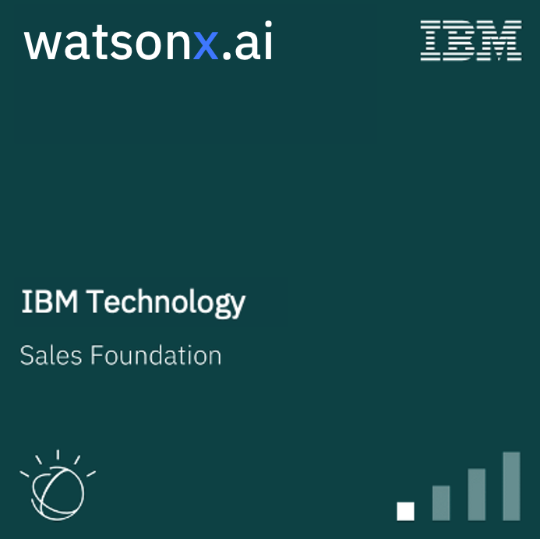
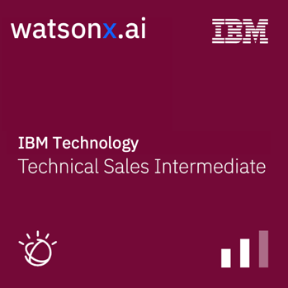
Call to action
1
Challenge yourself to deliver a watsonx briefing for each of your clients
Leverage the watsonx.ai Sales Kit, generative AI whitepaper and watsonx.ai video on Seismic
Engage clients in watsonx.ai pilot: https://ibm.biz/watsonx-pilot
2
Get Prepared - Complete required learning & earn your watsonx.ai Sales Foundation badge
AI Fundamentals L1
Watsonx L1
Notes:
Challenge yourself to deliver a watsonx briefing for each of your clients and ensure to:
Prioritize using entry points just discussed
Establish IBM’s Point of View (PoV) on generative AI and hybrid cloud before competitors do.
Sales Kit will help sellers follow the client engagement model with videos, and client presentations, which is an extremely helpful 1-pager and an FAQ.
In partnership with Product Management to get a head start on skills - the watsonx.ai Activation team on the technical side in each market to assist sellers along with IBM’s Americas Data & AI sales + tech sales teams
Earn the watsonx.ai Sales Foundation badge
There is material from WW enablement that covers AI Fundamentals, and watsonx.ai, including IBM’s foundation model story, differentiation, competitive objection handling and entry points.
Look out for upcoming education
Get done early to get a head start
Notes:
Sales kit - https://ibm.seismic.com/Link/Content/DCJH7MbqmMBmG8MPFjm2jWWfjgbP
Link for AI Fundamentals - https://yourlearning.ibm.com/activity/PLAN-402D037C5668?planIdFromParentTab=PLAN-AF3B8C30E8C1&sectionIdFromParentTab=SECTION-A&planIdForChildTab=PLAN-402D037C5668
Link for Watsonx L1 - https://yourlearning.ibm.com/activity/PLAN-872FB6605CA8?planIdFromParentTab=PLAN-AF3B8C30E8C1&sectionIdFromParentTab=SECTION-A&planIdForChildTab=PLAN-872FB6605CA8

Slide 44







Resources
Seismic
Internal
External
watsonx
watsonx.ai
watsonx.data
watsonx.governance
watsonx blog
watsonx sales tactics
SalesZone AI for Business
Behind the news
watson
watsonx
watsonx.ai
watsonx.data
watsonx.governance
Enablement
Events
FAQ
AI for Business learnings
Generative AI enablement series
watsonx rally hosted by Rob Thomas & Dario Gil
More to come...
watsonx.ai tech preview (clients)
watsonx.ai alpha environment (IBMers)
https://ibm.seismic.com/Link/Content/DCGq8T9hmFHbF82P2PPmQH8jpmBB
Notes:
This self-explanatory slide provides links to a variety of reference information on watsonx and watsonx.ai

Slide 45
Notes:
This self-explanatory slide does not require speaker notes.

